Slide 1
VIRTUAL OPEN HOUSE
MBTA Community Zoning

Slide 2
Hello and thank you for taking the time to help us to develop the best plan for Marblehead.
This an opportunity to learn about MBTA Community Zoning and tell us about what your thoughts are on the challenges you see, the benefits, the locations or the process.
THANK YOU !

Slide 3
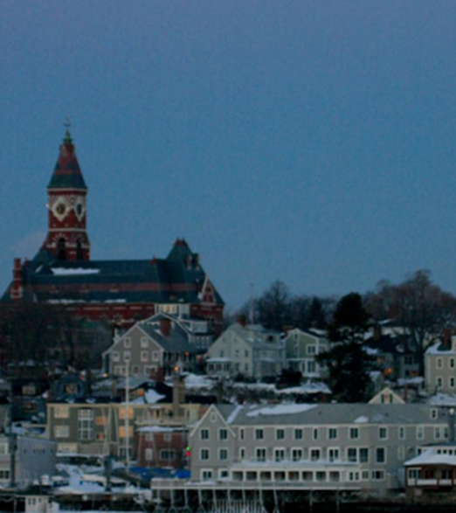
What is MBTA Zoning?
MBTA Communities refers to Section 3A of Massachusetts General Law Chapter 40A, as passed by the state legislature in 2021
The law requires that so called MBTA Communities must zone for “at least one district of reasonable size in which multi-family housing is permitted as of right” at a minimum of 15 units per acre

Slide 4
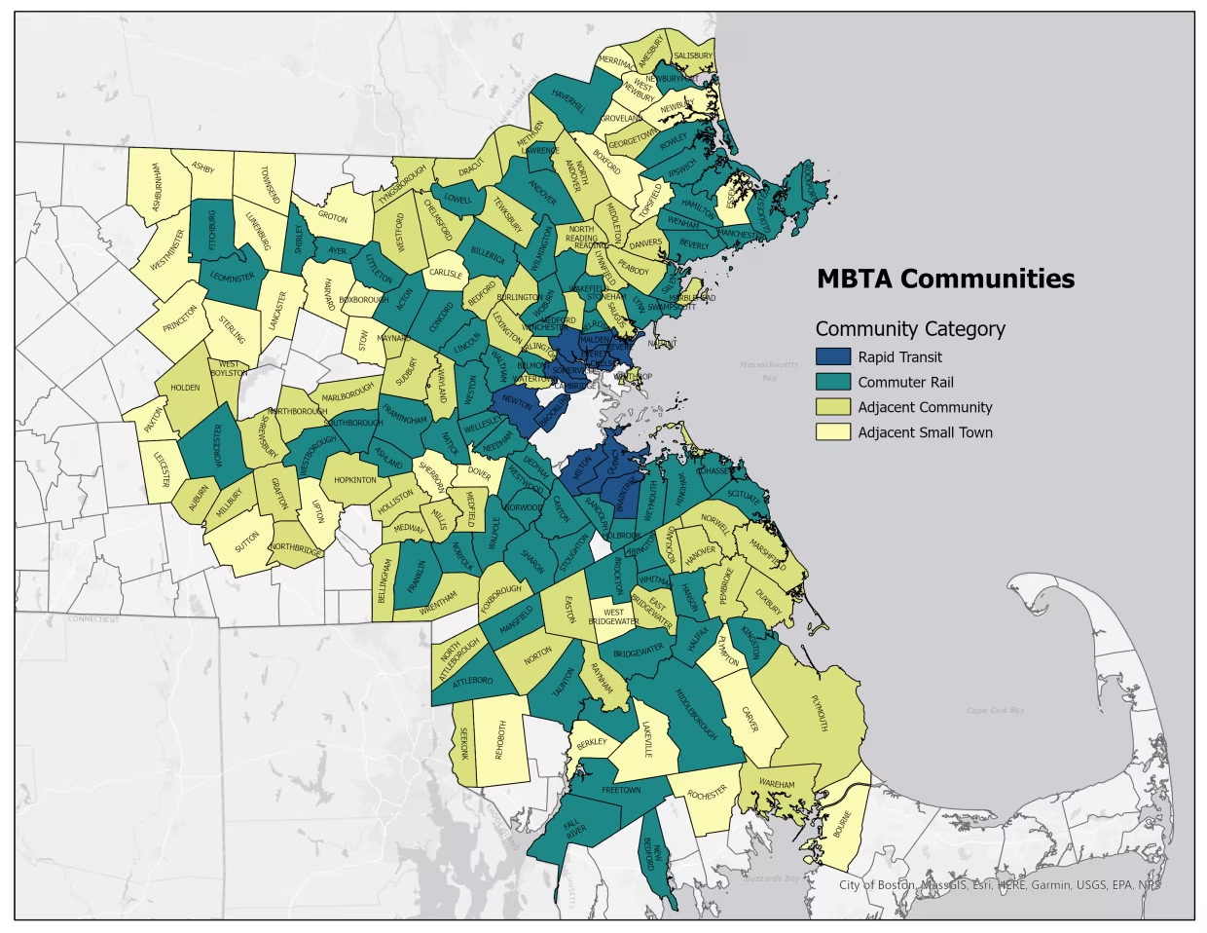
MBTA Communities
177 communities in the Commonwealth are included
Marblehead is classified as an Adjacent Community (adjacent communities are those that are adjacent to municipalities that contain MBTA stations).

Slide 5
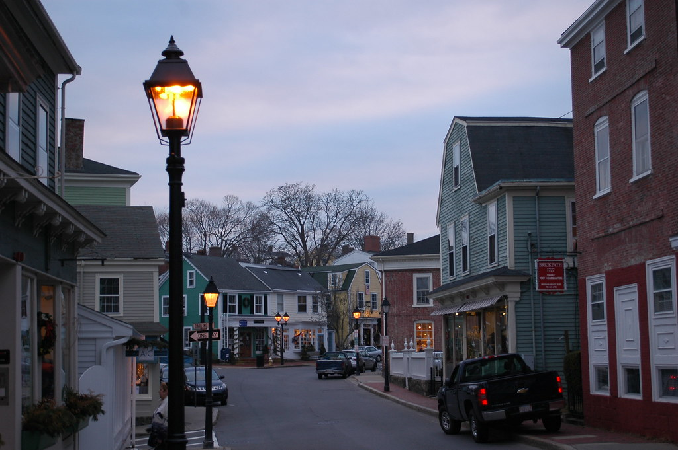
What does it mean for Marblehead
Marblehead is 2,771 acres in size. As an adjacent community, we must have zoning that is, at a minimum equal to 1% of our total land area. Thus, to comply, we need 27 acres zoned at a density of at least 15 units per acre and allowed as a matter of right
We also must zone for 10% (897) of the total number of housing units. Marblehead has 8,965 total housing units

Slide 6
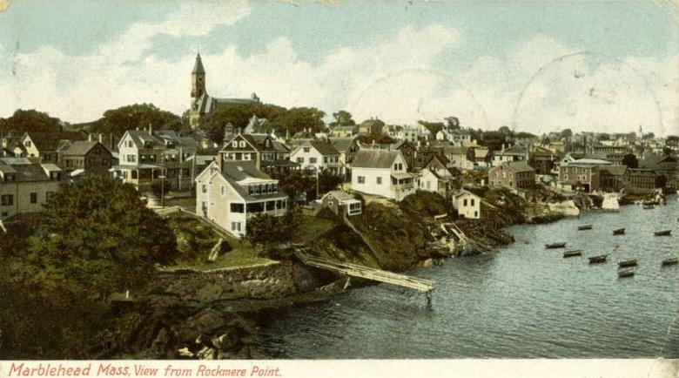
The district(s) can be located anywhere within the town.
It can be more than one district to reach the total. However, any one district must be no less than five acres in size.

Slide 7
What happens if we don’t comply? Failure to comply with the law results in a loss of eligibility for certain funding programs.
Community Planning Grants
Massachusetts Downtown Initiative
Urban Agenda
Rural and Small-Town Development Fund
Brownfields Redevelopment Fund
Site Readiness Program
Underutilized Properties Program
Collaborative Workspace Program
Real Estate Services Technical Assistance
Commonwealth Places Programs
Land Use Planning Grants
Local Acquisitions for Natural Diversity Grants
Housing Choice Initiative
Local Capital Projects Fund
Mass Works infrastructure program
Municipal Vulnerability Preparedness Planning and Project Grants

Slide 8
Further
The State Attorney General has clarified
MBTA Communities cannot avoid their obligations under the Law by foregoing this funding.
All MBTA Communities must comply with the Law. Communities that fail to comply with the Law may be subject to civil enforcement action.
The Law requires that MBTA Communities “shall have” a compliant zoning district and does not provide any mechanism by which a town or city may opt out of this requirement.
MBTA Communities that fail to comply with the Law’s requirements also risk liability under federal and state fair housing laws.

Slide 9
A code that regulates how we can use land.
Includes:
Shape (height and size) of buildings
Distance between buildings and other land uses
What the land can be used for
Residential - single or multifamily
Commercial
Industrial
Can also include requirements for things like parking, affordability, and design standards

Slide 11
Marblehead presently has 15 zoning districts and two overlay districts
The first zoning bylaw was adopted in the 1920 hundreds of years after the establishment of the town and has been amended many times

Slide 12
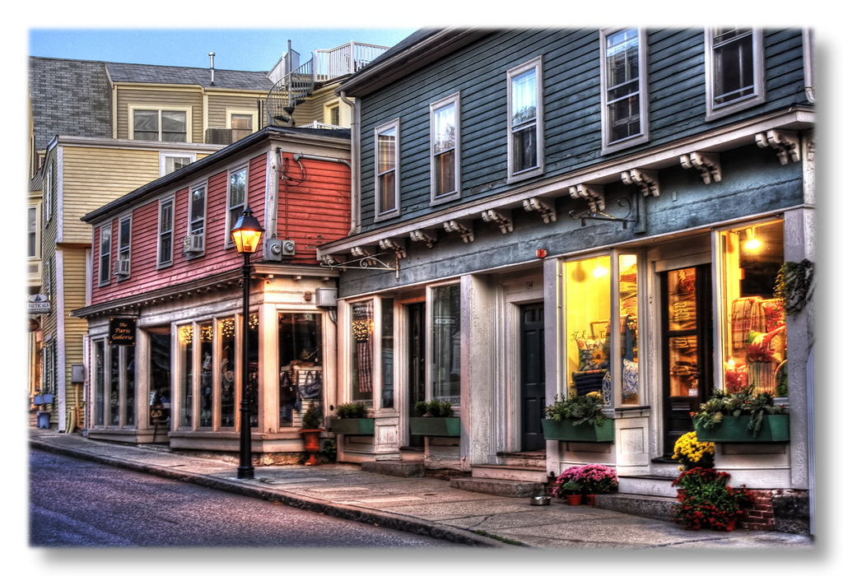
15 units per acre
This density is all around us – we already have this type of density and much denser
Notes:
All around us

Slide 13
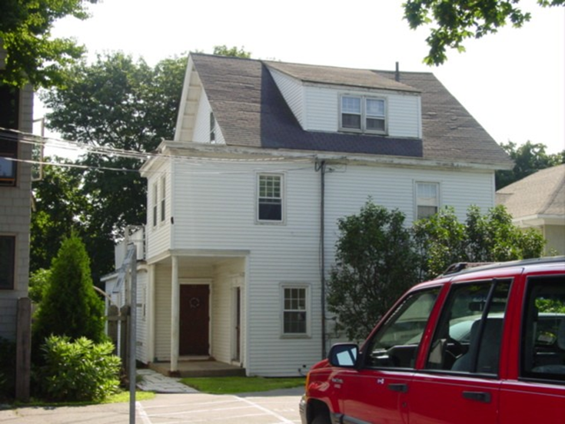
State Street
No. of Units: 4
Parcel Acreage: .256
Density: 15 units/acre
182 Pleasant Street
No. of Units: 4
Parcel Acreage: .216
Density: 18 units/acre
53 Allerton Place
No. of Units: 4
Parcel Acreage .114
Density: 35 units/acre

Slide 14
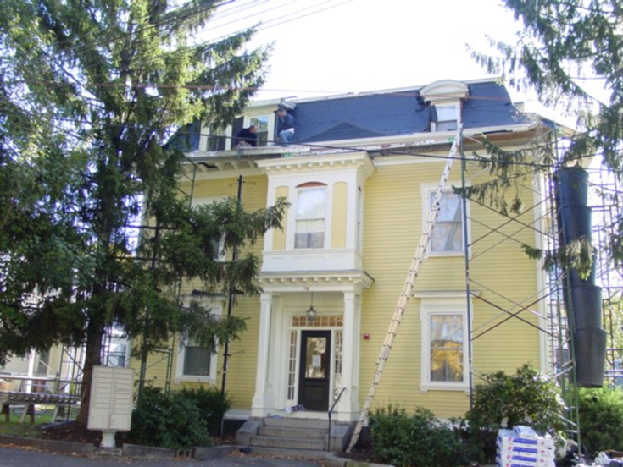
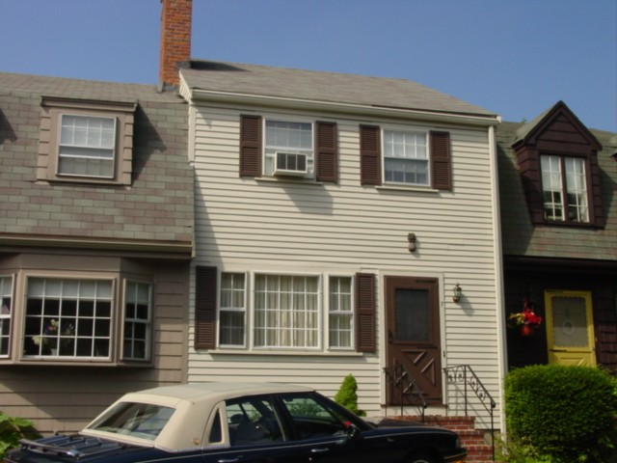
8 Franklin Street
No of Units: 20
Parcel Acreage: 0.477
Density: 41 units/acre
Bradford Court
Residential Units: 23
Parcel Acreage: .977 total
Parcel Density: 23 units/acre
78 Pleasant Street
No. of Units: 10
Parcel Acreage: .20
Density: 50 units/acre

Slide 15
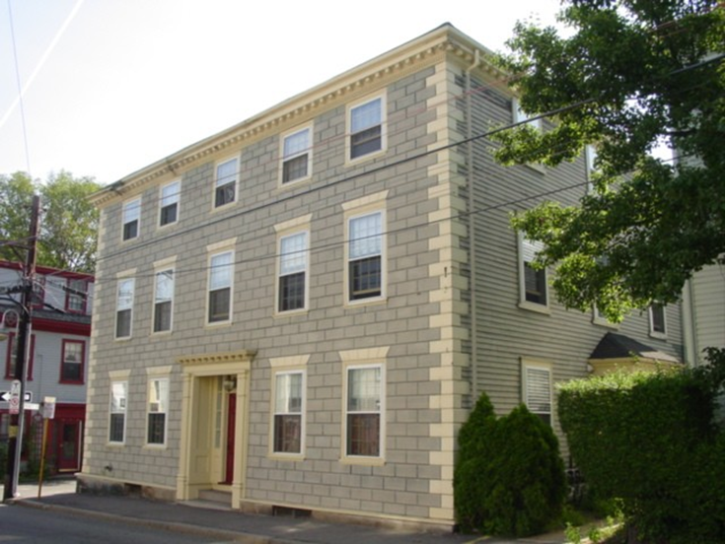
29 Pleasant Street
No. of Units: 9
Size of parcel: .08 acres
Density: 112 units/acre
1 bedroom units
52 Washington Street
No. of Units: 9
Size of parcel: .09 acres
Density 100 units/acre
1- & 2-bedroom units
18 /20 Darling Street
No. of Units: 5
Size of Parcel .208 acres
Density: 24 units/acre

Slide 16
28 Darling Street
No. of Units: 5
Parcel Size: .09 acre
55 units per acre
59 Gregory Street
No of Units 4
Parcel Size: .188
21 units per acre

Slide 17
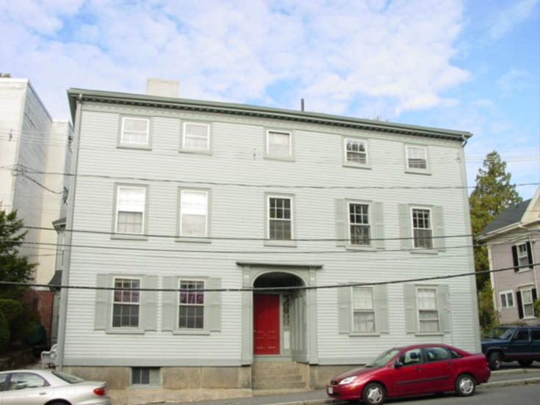
Reserve at Olivers Pond
No of Units: 20
Density:13 units per acre
217 Washington
No of Units: 7
Parcel Size: .092 acres
Density: 76 units/acre
Marblehead Highlands
No. of Units: 88
Parcel size: 4.4 acres
Density: 20 units per acre

Slide 18
If we already have this density, why aren’t we in compliance?
Although Marblehead has many multi family housing units at high densities, they are scattered throughout the town.
We are required to have at least one district of a certain size and density where multi family use is allowed as a matter of right.

Slide 19
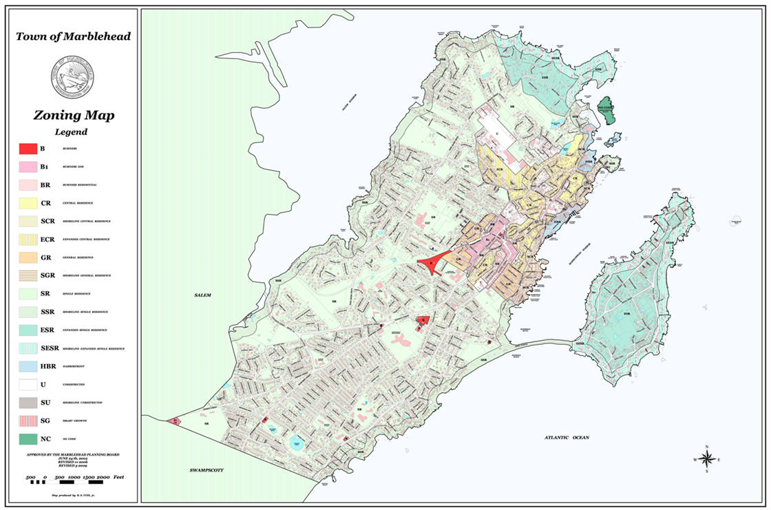
Presently we allow multi family by special permit in our unrestricted district
We also allow row houses (a type of multi family) in four of our zoning districts by special permit and we allow mixed use commercial with residential above in one district as a matter of right and by special permit in the others

Slide 20
Marblehead Housing Stock

Slide 21
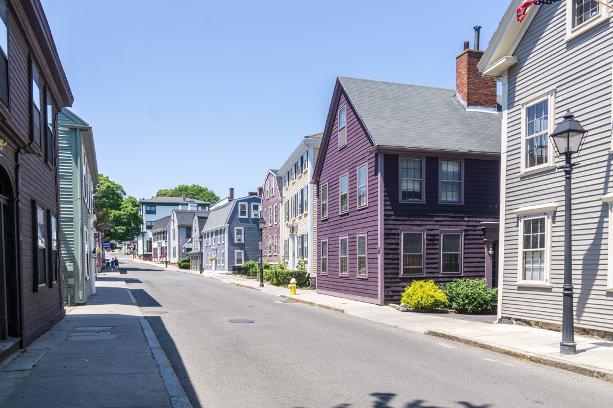
This density already exists in Marblehead
The housing type – multi family already existing in Marblehead

Slide 22
This is a zoning mandate not a building project or a production mandate
Vinnin Square Smart Growth zone was adopted by Town Meeting in 2009 - the first application was in 2022
The Incentive zoning bylaw, which allows an increase in density townwide, was adopted in 1990 – the first and only application to date was in 2013 and the project was completed in 2021
Because the town has less than 10% affordable housing the town is subject to Chapter 40B. This allows a density increase in exchange for 25% of the housing units being affordable housing units. This can happen in any location in the town at any time. The law has existing since 1969 Marblehead has permitted four 40B developments two have been built and one is under construction the other was not built

Slide 23
How can we do this?
Take the existing district where multi family housing is permitted right now by special permit and make the changes to the dimensional regulations and allow by right
Look at expanding existing smart growth districts
Look at any large open parcel(s) above 5 acres or areas with underutilized buildings and properties and create a five acre district
Develop and apply criteria
Develop strict guidelines so even as of right it has to be a certain size shape and look
There are many, many ways to approach this

Slide 24
What are challenges of multi family housing ?
Infrastructure capacity
Changes to the Character of Marblehead
Harmonious Integration of housing styles
IMPACT ON SCHOOLS
TRAFFIC

Slide 25
Benefits of multi family housing
Can provide a variety of housing options, accommodating individuals and families with different needs, preferences, and budgets
Shared spaces in multi-family communities can foster social interaction, creating a sense of community and belonging among residents
Multi-family zoning can support the development of affordable housing options, helping to address housing affordability issues
New growth can help take tax pressure off existing residents by creating new tax revenue
This Photo by Unknown Author is licensed under CC BY-NC-ND

Slide 26
What have we done so far?
No decisions have been made on where to put this district or districts
Identified stakeholders to contact
Looked at model bylaws
Began going to various boards to present what this is about
Analyzed Unrestricted District
Smart Growth expansion areas

Slide 27
What have we done so far?
No decisions have been made on where to put this district or districts
Identified stakeholders to contact
Looked at model bylaws
Began going to various boards to present what this is about
Analyzed Unrestricted District
Smart Growth expansion areas

Slide 28
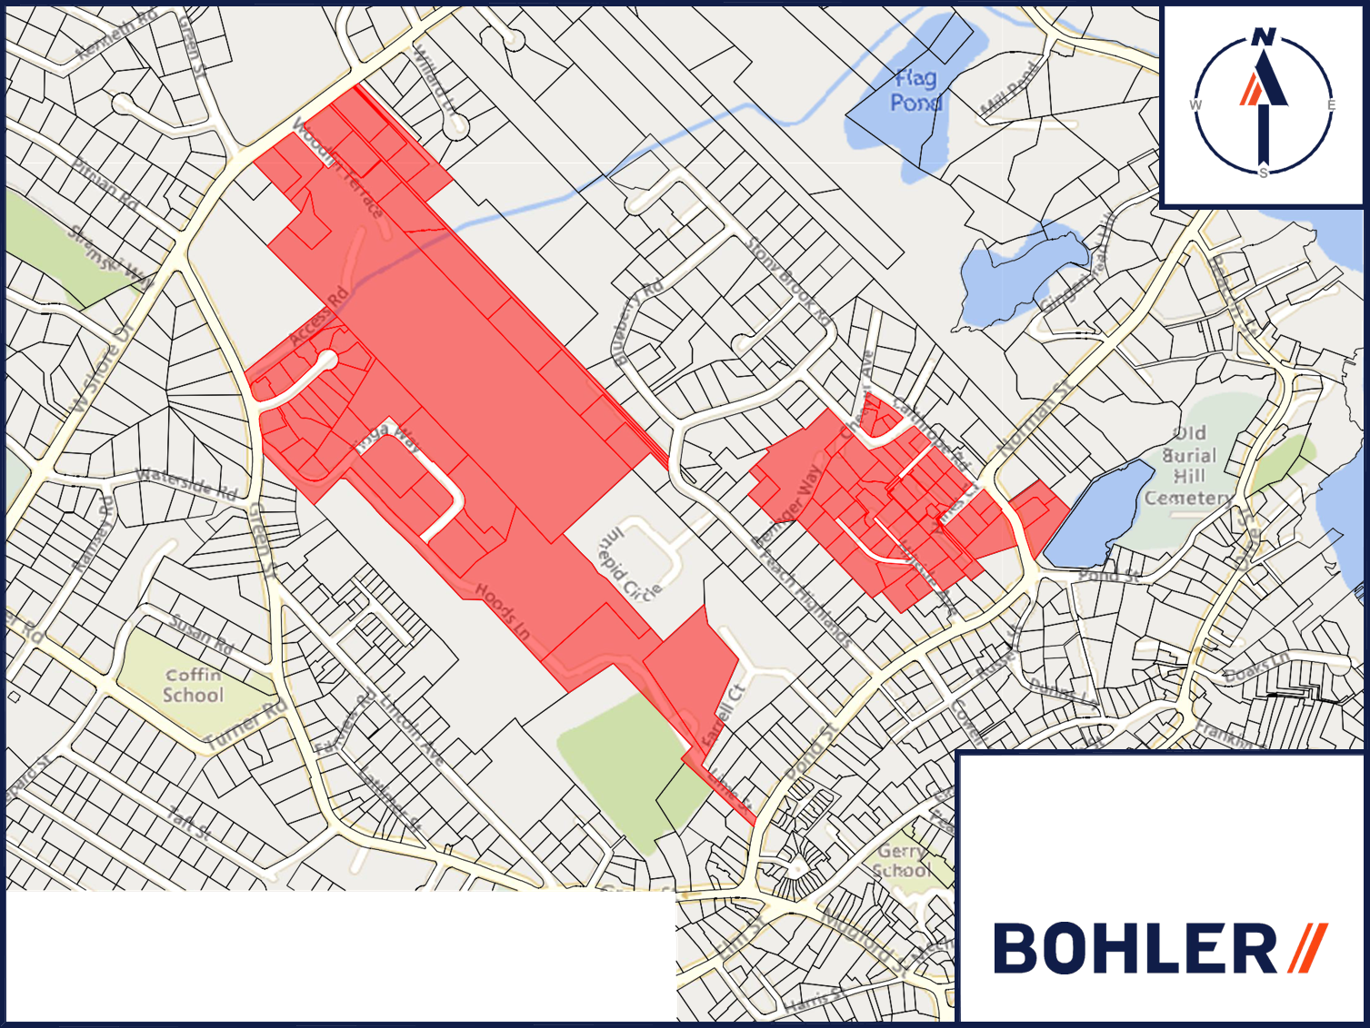
Existing Unrestricted District

Slide 29
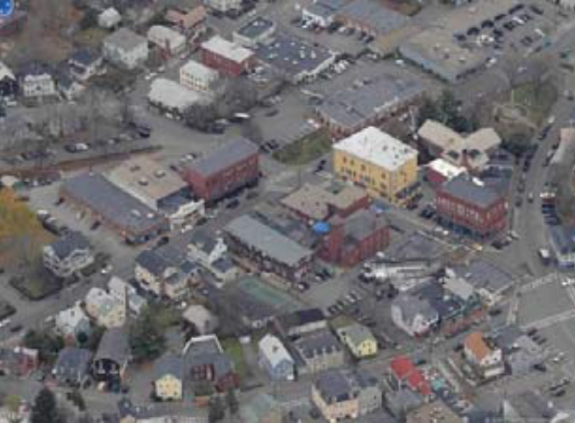
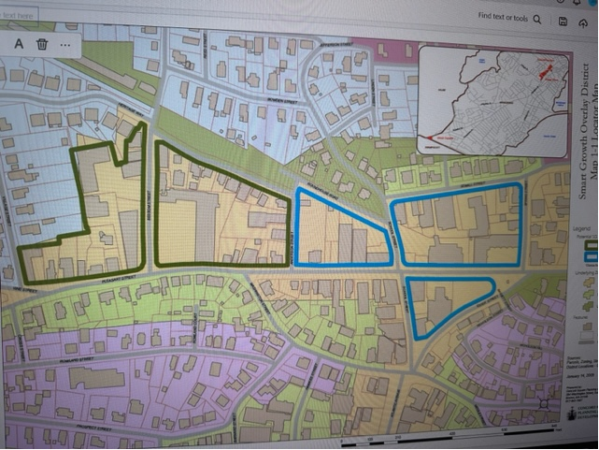
Expanding Pleasant Street Smart Growth District
To promote low impact, green, and sustainable development that is pedestrian and public transit friendly.
To ensure high quality site planning, architecture and landscape design that is consistent with the distinct visual character and identity of downtown Marblehead and provides development with safety, convenience and amenities appropriate to its residential and mixed-use nature.
To establish development standards that ensure context-sensitive design and creative site planning in the reuse of existing buildings and construction of new buildings.
To provide for diversified housing stock at a variety of costs near the local bus lines, including a percentage of affordable housing, that meets the needs of the Town’s population and promotes diversity.
To generate positive tax revenue, and to benefit from the financial incentives provided by M.G.L. Ch. 40R, while providing the opportunity for housing choice among households of varying incomes, ages and sizes.

Slide 30
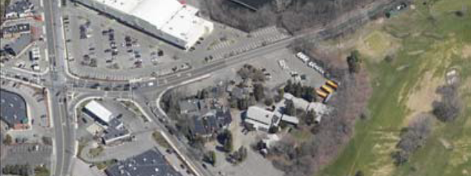
Expanding Vinnin Square Smart Growth District

Slide 31
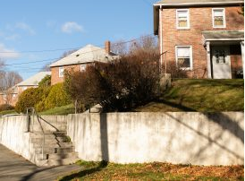
Broughton Road
Existing family housing owned and operated by the Marblehead Housing Authority
It was constructed in the 50’s and the new area in early 80’s
The Housing Authority is exploring redoing this area now
This area could be included in the overlay
It is approximately 8 acres in size

Slide 32
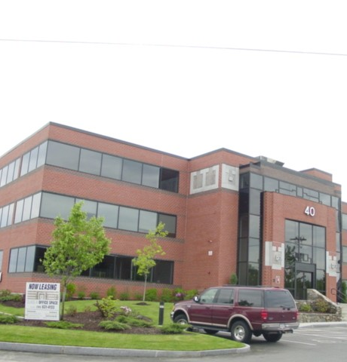
Under utilized buildings

Slide 33
Multi Family can take many forms

Slide 34
Midrise
Courtyard complex

Slide 35
Multiplex
Side by side

Slide 36
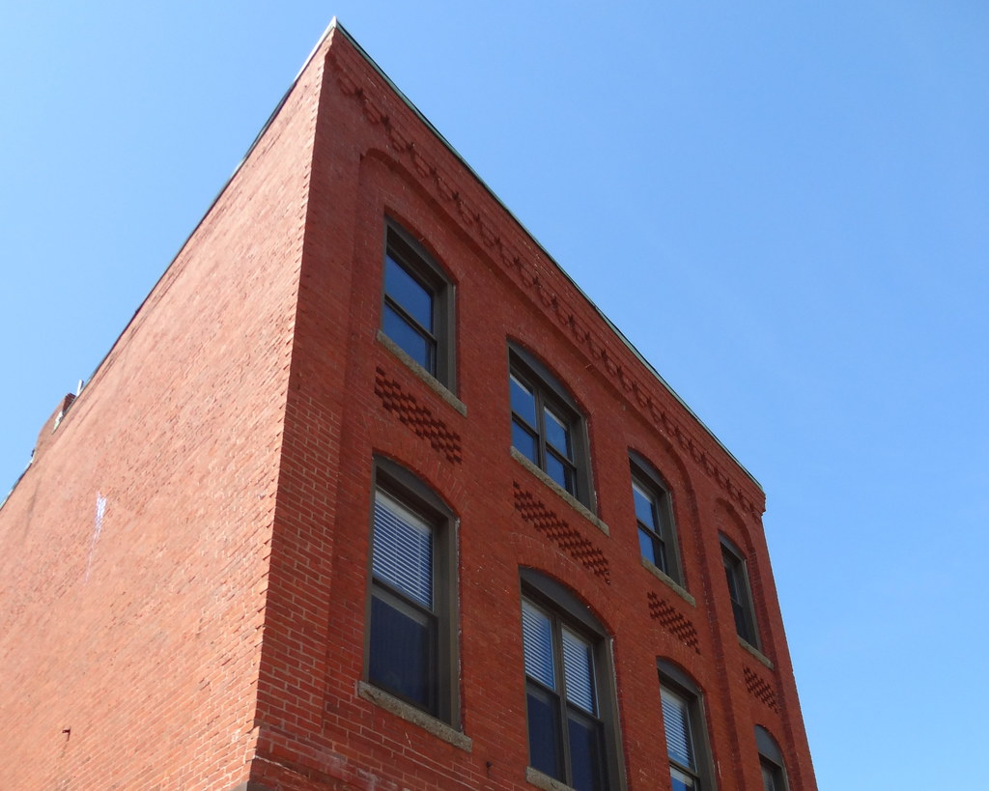
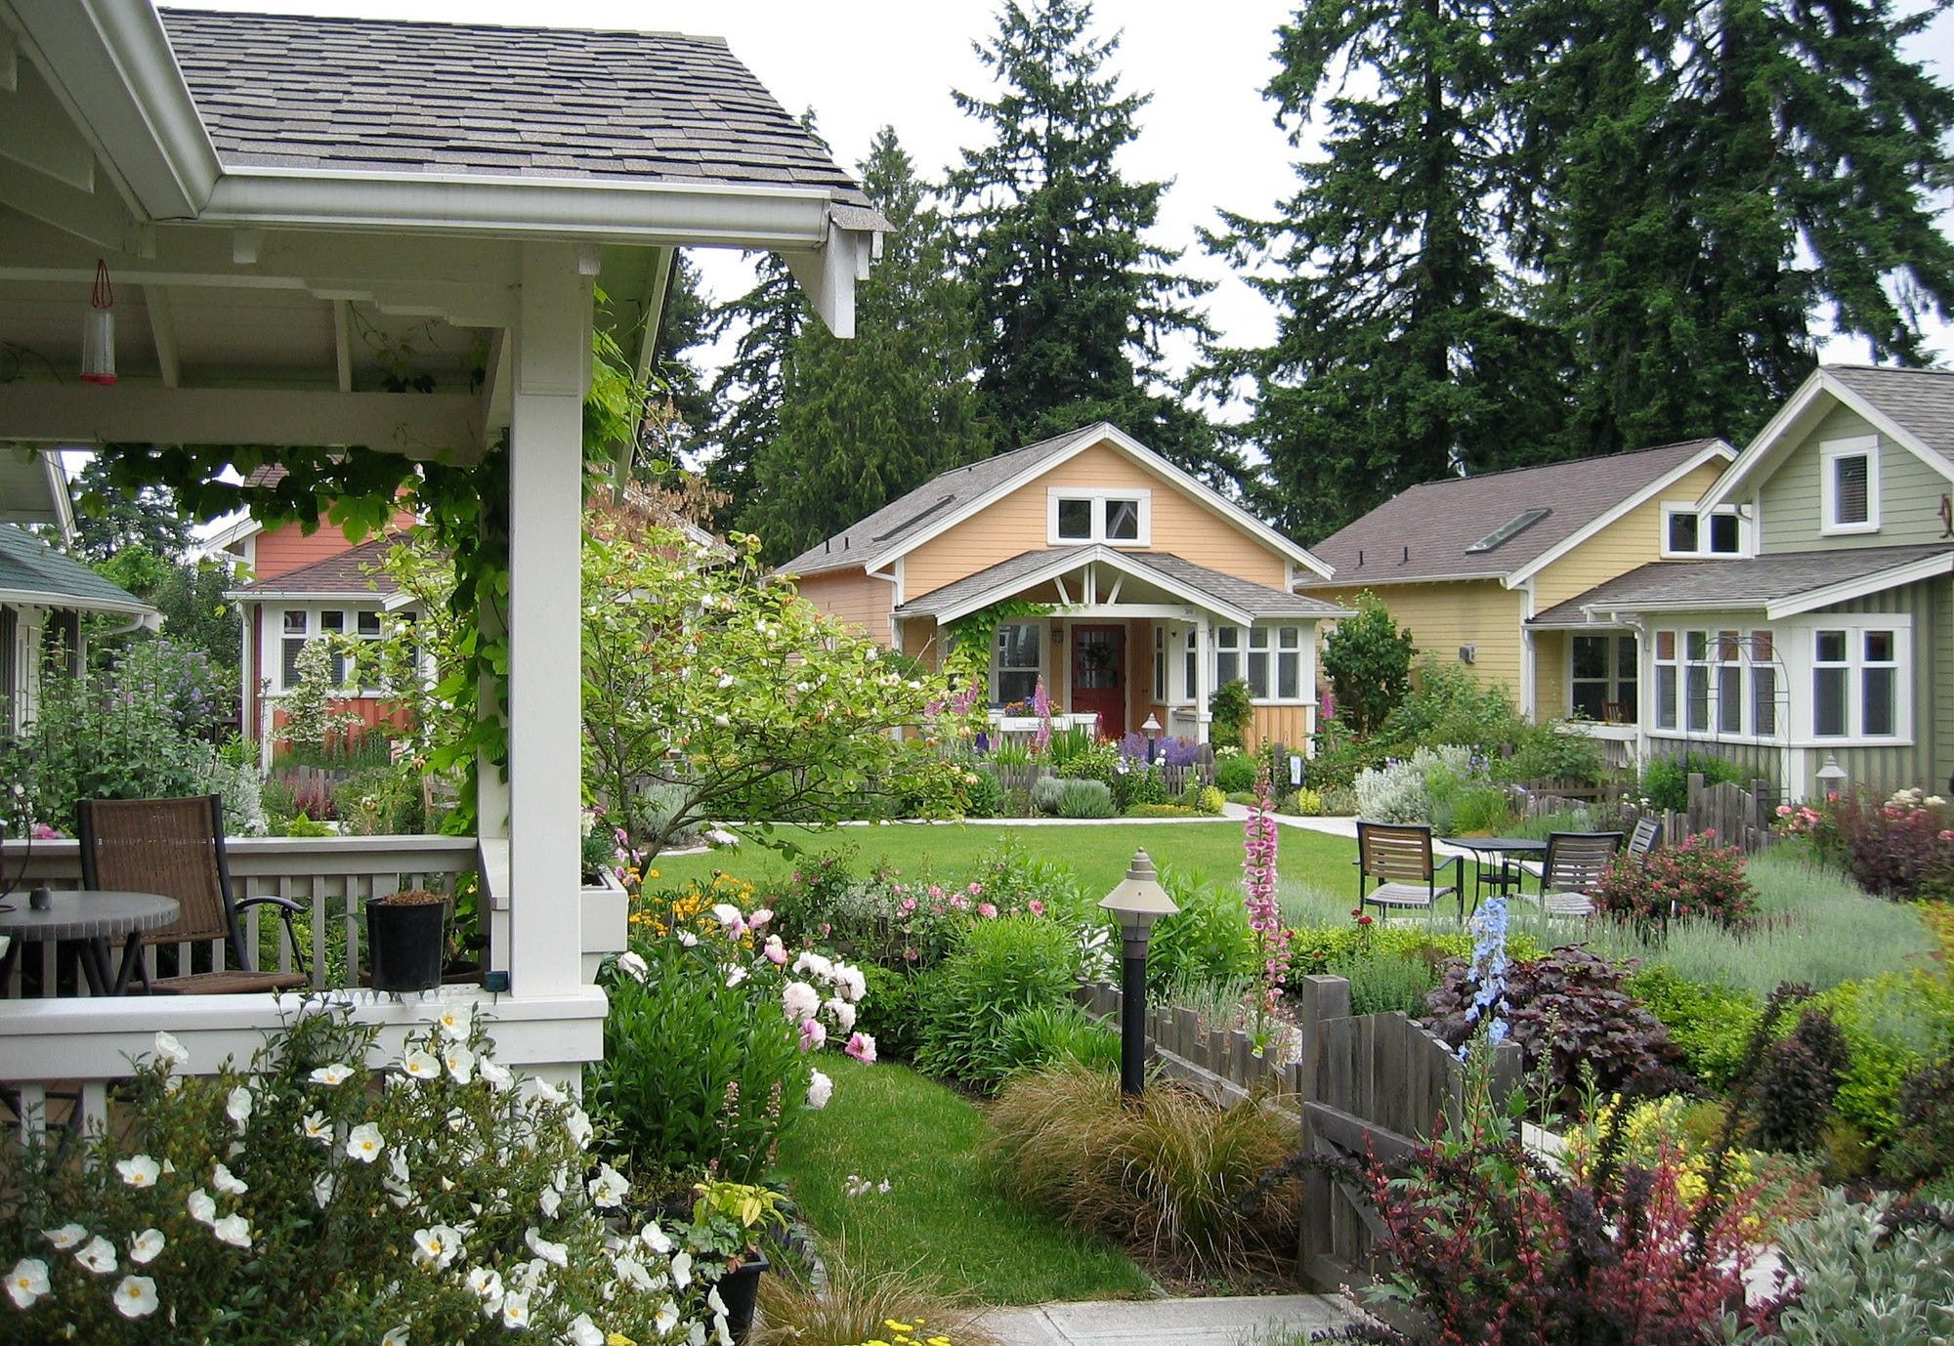
Cottage style
Adaptive reuse

Slide 37
problems or concerns
It might change Marblehead’s character
It might create so many new units that it effects the schools
It might increase traffic

Slide 38
Also tell us what you think might be good about it
Older adults can downsize & stay in the community
1
College kids can come home & rent
2
Small businesses can retain employees
3
Create some affordable housing units
4
Grandparents can stay close to their grandchildren
5
Could create new housing types
New growth could create tax revenue

Slide 39
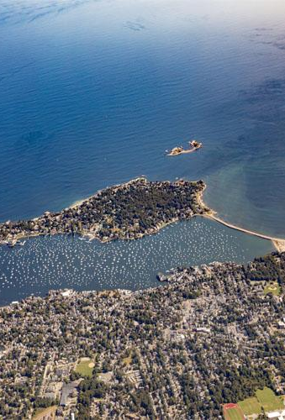
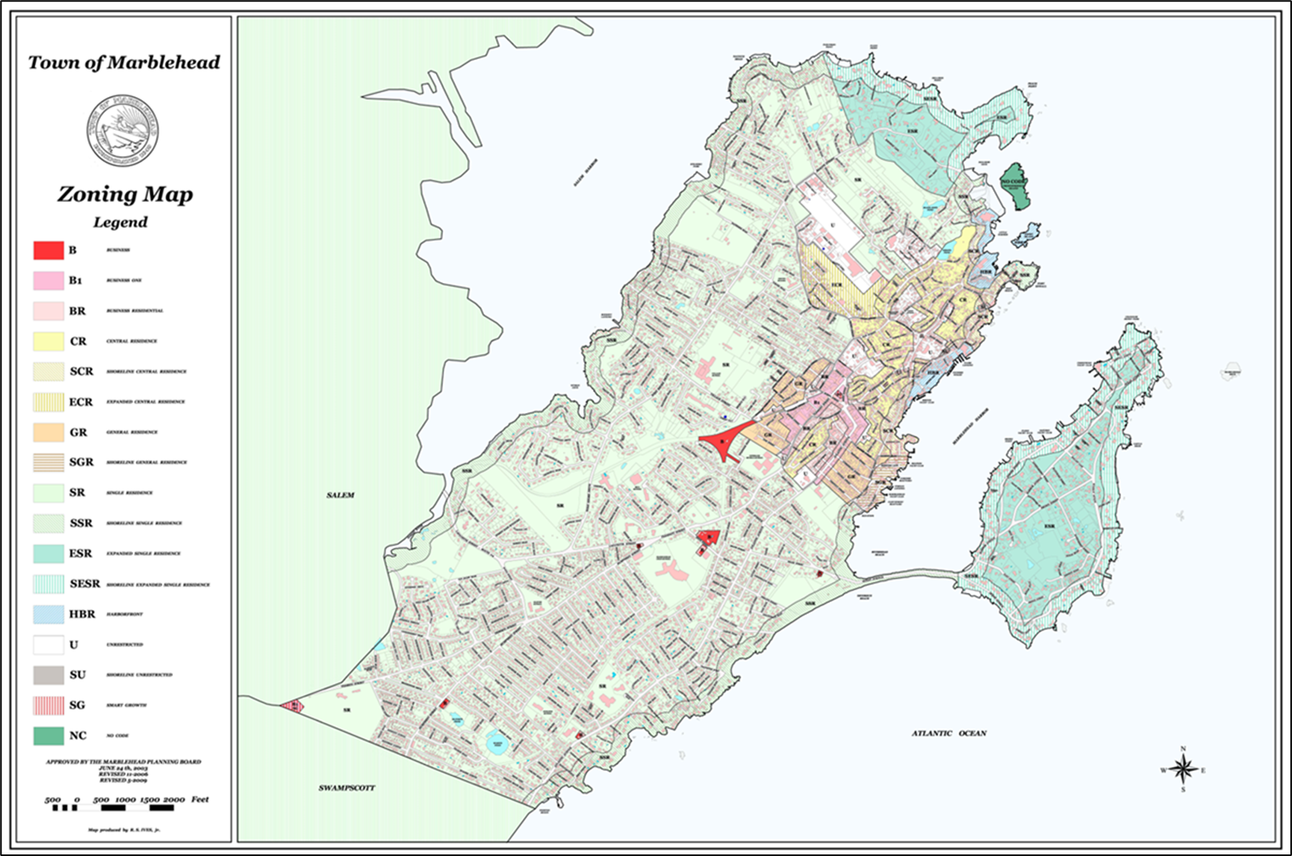
Other locations

Slide 40
Exercise
We have established that we need to go through this exercise to see how it might impact and/or benefit the town
The more input we get, the more we can work to develop something that could work for Marblehead
We have the ability as we craft our zoning to choose the locations, set dimensional controls (lot size, setbacks, lot coverage, etc.), provide design guidelines, parking requirements, and more
Town Meeting will decide ultimately

Slide 41
Results of exercise

Slide 45
Timeline
Deadline for Compliance is December 2024
Spend the next month soliciting more input continue identifying and talking to stakeholders and focus groups
The planning board has discussed forming a task force to involve a wider range of interests
Analyze identified locations – technical assistance from grant for engineering consultant
Develop a draft plan and present more community engagement – virtual meeting, in person meeting, hybrid etc.
Finalize preferred plan based on input
Submit to town warrant end of January
Education and outreach February to May
Vote at Town Meeting May 2024

Slide 46
Questions or Comments?
Please email Town Planner Rebecca Cutting @ RebeccaC@Marblehead.org

