Slide 1
Traffic Safety Advisory Committee Town Planner Transportation Update
Rebecca Curran Cutting
December 18, 2024

Slide 2
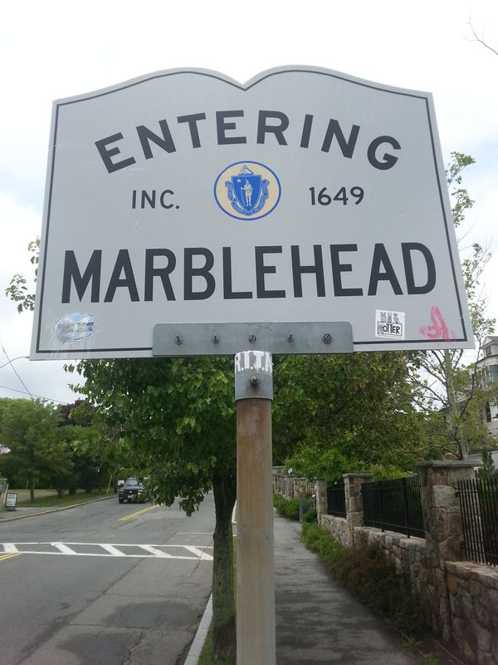
Agenda
Rail Trail History
Overview & Status of Rail Trail Projects
Lead Mills
Border to Boston
DCR Grant
Other Projects
Bike Plan

Slide 3
Marblehead Rail Trail
The RROW was owned and controlled by the Light Dept and the Water & Sewer Dept as a Utility corridor for many years and informally used as a path.
In 2018 the town worked out an agreement and entered an MOU with the utilities.
An article voted at town meeting formalized its use as a recreational trail through an easement.

Slide 4
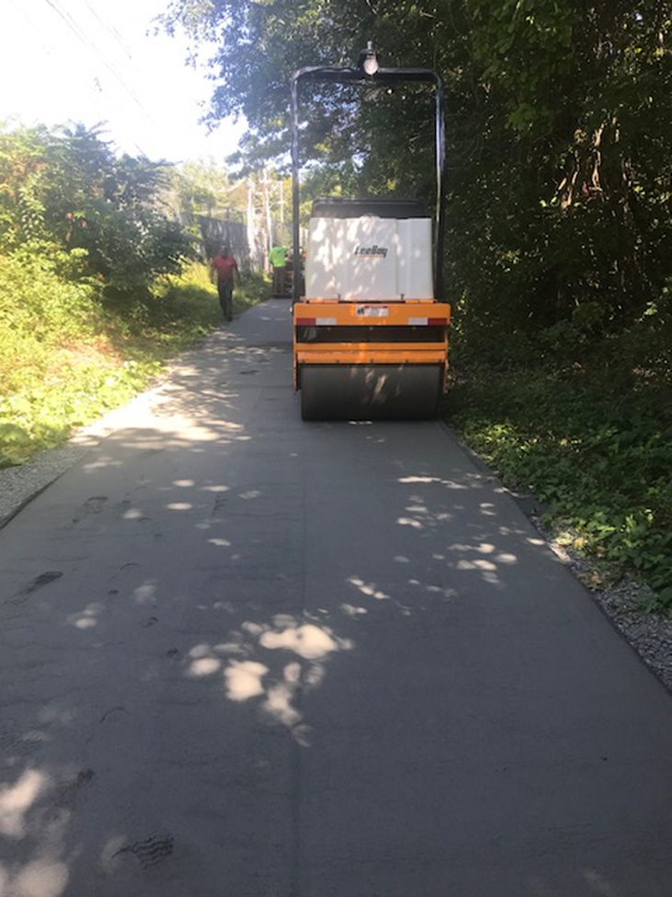
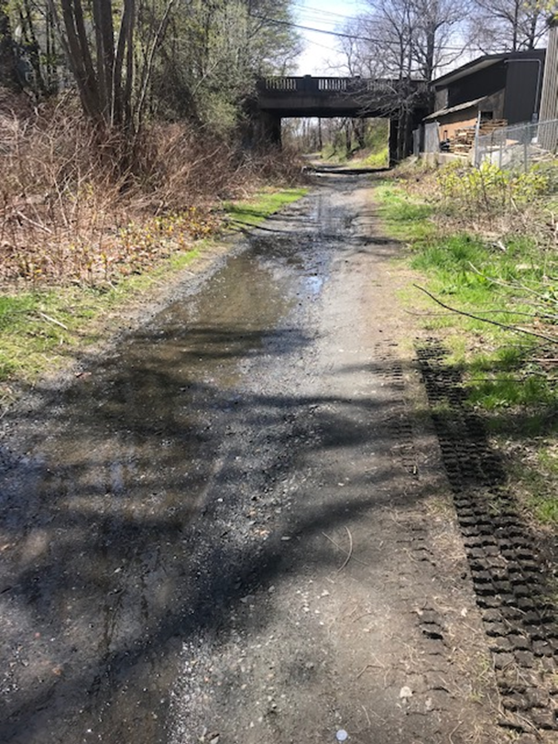
The town applied for and received a grant from the Dept of Conservation and Recreation (DCR) to fix the worst areas; removing stones, regrading with new stone dust to fill low spots and regrading areas with puddling. That work was completed in 2019.

Slide 5
DCR 2019 Grant
The town applied for and received another DCR grant to create an overall master plan for the Rail Trail.

Slide 6
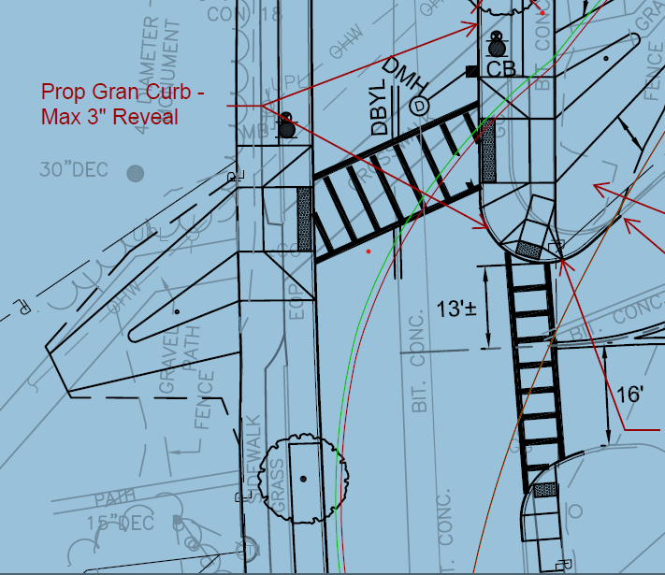
Crossings – West Shore. Pleasant, Smith
The town applied for and was awarded a complete streets grant to implement one of the priority recommendations which was to improve the crossings at major streets. This was completed in December of 2022

Slide 7
Another DCR Grant for Lead Mills 75% design

Slide 8
Lead Mills ARPA
$1.4 mill of ARPA funds was designated by the Select Board
For permitting including AUL on the site, a coastal bank (triggers MEPA), Conservation Commissions (Salem and Marblehead), ACE review and EJ outreach and then bidding and construction.

Slide 9
Lead Mills – changes
The 75% plan included replacing both bridges – after more discussion with the utilities and public safety, it was determined they did not need vehicular access and therefore can simply replace the surfaces and railings and make universally accessible.
This will allow the funds to further extend the trail improvements in accordance with the master plan.
The design will be expanded to include improvements to West Shore an area that has obstructions and puddling.

Slide 10
Schedule
An RFQ for a professional engineer and LSP will be issued shortly for this work to take the 75% design to 100% and then begin permitting.
Before bidding, new cost estimates will be prepared and the town will structure the bid to maximize funds.

Slide 11
Border to Boston Earmark
MassDOT approved the $175,000 federal earmark for the design of the trial improvements from Swampscott Line to Smith Street.
RFP will be issued shortly

Slide 12
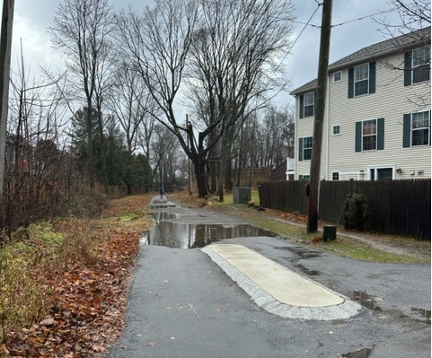
DCR Trails Grant - Prototype
Pleasant Street to Smith Street
650 linear feet
Due February 1, 2024

Slide 13
Bicycle Plan RFP
PROJECT OBJECTIVES
The general objective of this project consists of a planning process and plan that identifies and prioritizes bicycle improvements based determining the needs of bicyclists. The ultimate goal is improving the circulation environment for its bicyclists.
The purpose of the plan is to:
• Guide the Town in creating a lasting bicycle transportation program.
• Guide capital investments and identify additional local, State, and Federal funding options.
• Identify convenient, attractive, and safe on-street, including vertically separated, as well as off-street routes for bicycling to important destinations
• Identify connections to other modes of transportation.
• Expand the existing bicycle system and improve bicycle travel throughout the community.
• Increase bike ridership in the Town.
• Improve the quality of the existing system, including connectivity within and between Marblehead neighborhoods.
• Promote safe bicycling and enhance bicycle safety including signage and education.
• Identify opportunities to connect bike accommodations with adjacent communities.

Slide 14
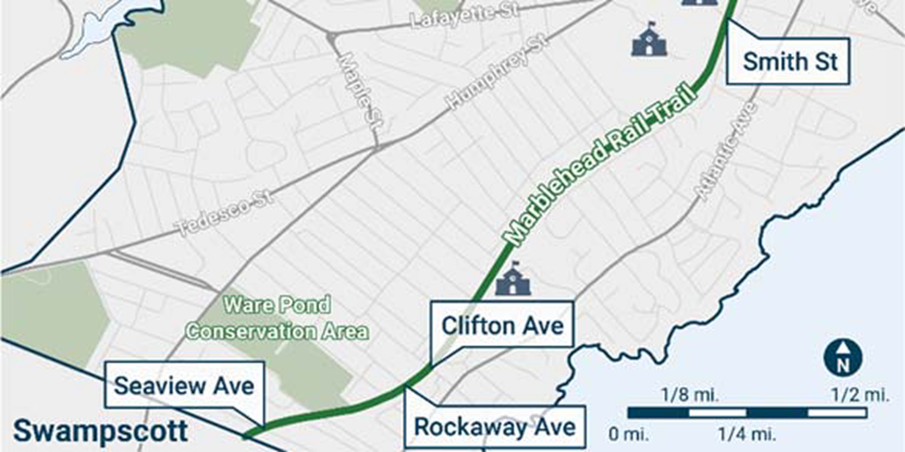
Summary
An RFQ is being issued for the design at Lead Mills and to West Shore
Concurrently, RFQ for the design and survey of the rail trail improvements from Swampscott Line to Smith Street.
In the interim DPW has been working on testing materials and best ways to address puddling and obstructions.
Smith to Segment DCR Grant
Eventually the entire Rail Trail will be reconstructed in accordance with the Trail Master Plan!!

Slide 15
Thank you

