Slide 1
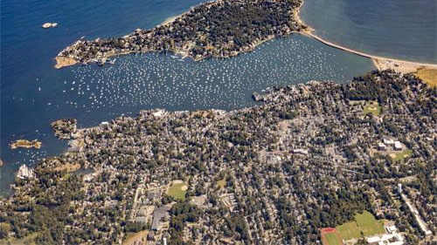
MBTA COMMUNITY ZONING Draft Compliance Model
January 16, 2024

Slide 2
What is MBTA Zoning?
MBTA Communities refers to Section 3A of Massachusetts General Law Chapter 40A, as passed by the state legislature in 2021
The law requires that so called MBTA Communities must zone for “at least one district of reasonable size in which multi-family housing is permitted as of right” at a minimum of 15 units per acre

Slide 3
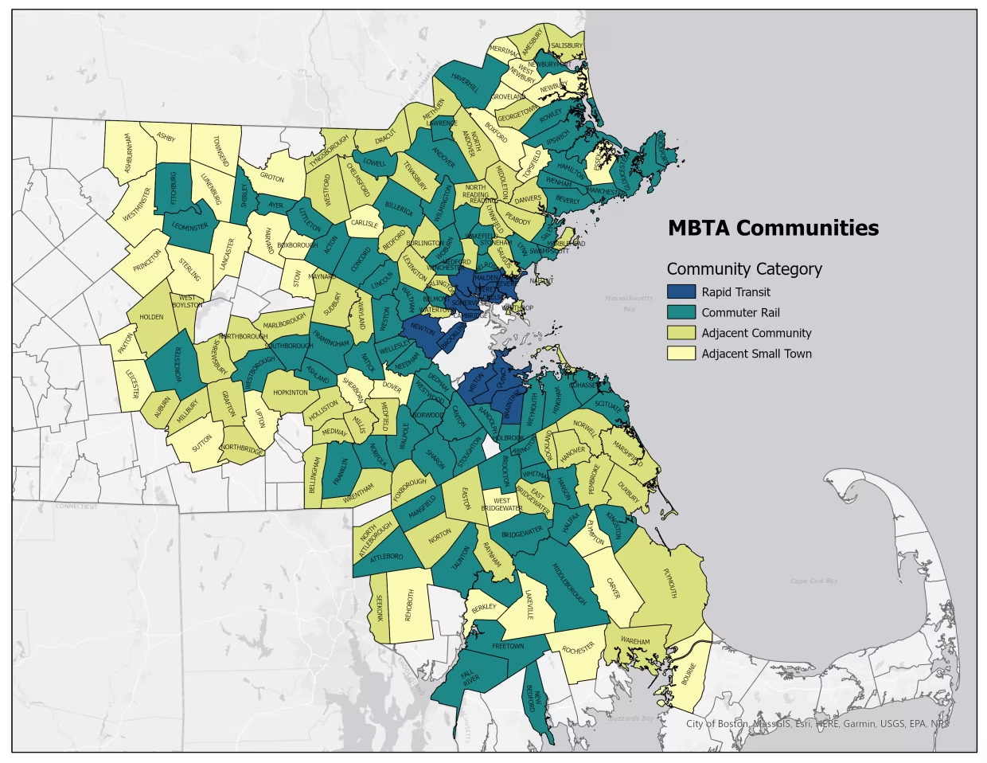
MBTA Communities
177 communities in the Commonwealth are included
Marblehead is classified as an Adjacent Community (adjacent communities are those that are adjacent to municipalities that contain MBTA stations).

Slide 4
What does it mean for Marblehead
Marblehead is 2,771 acres in size. As an adjacent community, we must have zoning that is, at a minimum equal to 1% of our total land area. Thus, to comply, we need at least 27 acres zoned at a density of at least 15 units per acre and allowed as a matter of right
We also must zone for 10% (897) of the total number of housing units. Marblehead has 8,965 total housing units

Slide 5
Parameters
The district(s) can be located anywhere within the town.
Not less than a total 27 acres
Can be more than one area
No one area less than 5 acres
One of the areas must be 50% of the total
Not less than the capacity of 897 units
Minimum density 15 units per acre

Slide 6
What happens if we don’t comply? Failure to comply with the law results in a loss of eligibility for certain funding programs.
Community Planning Grants
Massachusetts Downtown Initiative
Urban Agenda
Rural and Small-Town Development Fund
Brownfields Redevelopment Fund
Site Readiness Program
Underutilized Properties Program
Collaborative Workspace Program
Real Estate Services Technical Assistance
Commonwealth Places Programs
Land Use Planning Grants
Local Acquisitions for Natural Diversity Grants
Housing Choice Initiative
Local Capital Projects Fund
Mass Works infrastructure program
Municipal Vulnerability Preparedness Planning and Project Grants

Slide 7
Further
The State Attorney General has clarified
MBTA Communities cannot avoid their obligations under the Law by foregoing this funding.
All MBTA Communities must comply with the Law. Communities that fail to comply with the Law may be subject to civil enforcement action.
The Law requires that MBTA Communities “shall have” a compliant zoning district and does not provide any mechanism by which a town or city may opt out of this requirement.
MBTA Communities that fail to comply with the Law’s requirements also risk liability under federal and state fair housing laws.

Slide 8
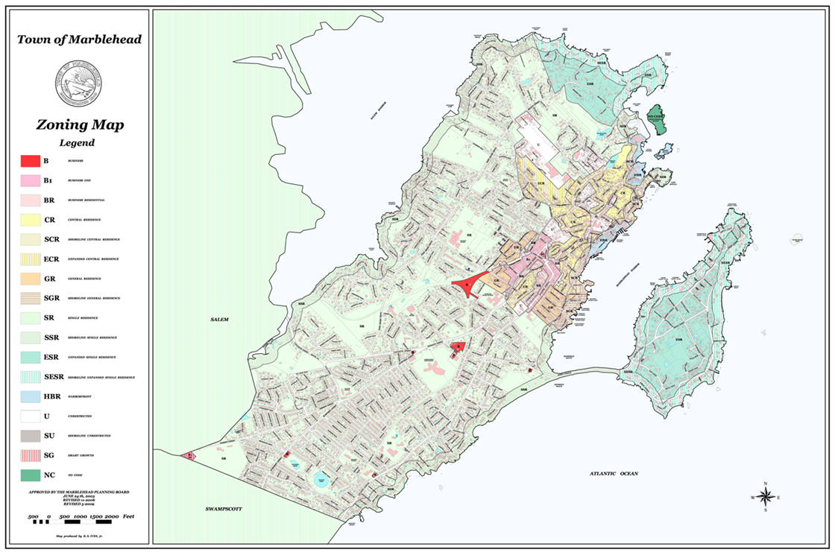
Marblehead presently has 15 zoning districts and two overlay districts
The first zoning bylaw was adopted in the 1920 hundreds of years after the establishment of the town and has been amended many times

Slide 9
But since there is one, we have been exploring how we might be able to comply in a way that benefits Marblehead.

Slide 10
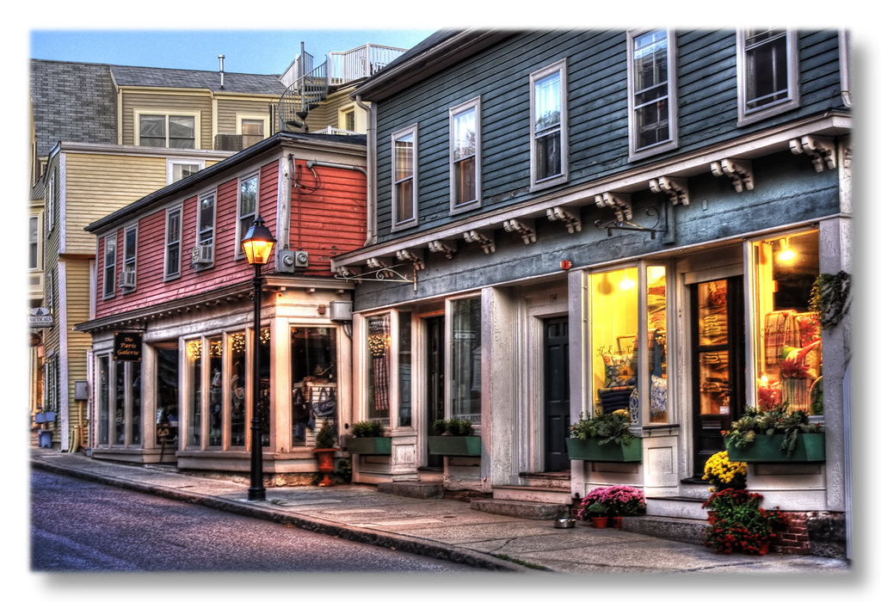
15 units per acre
This density is all around us – we already have this type of density and much denser
Notes:
All around us

Slide 11
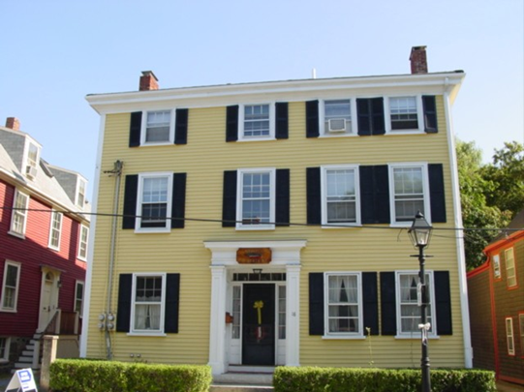
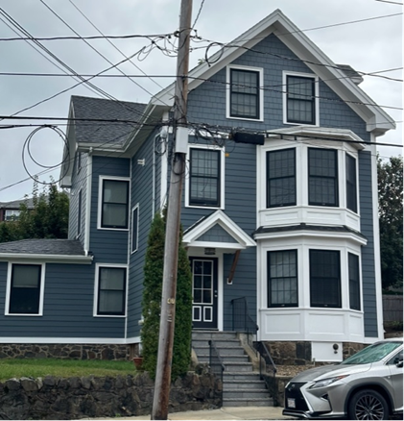
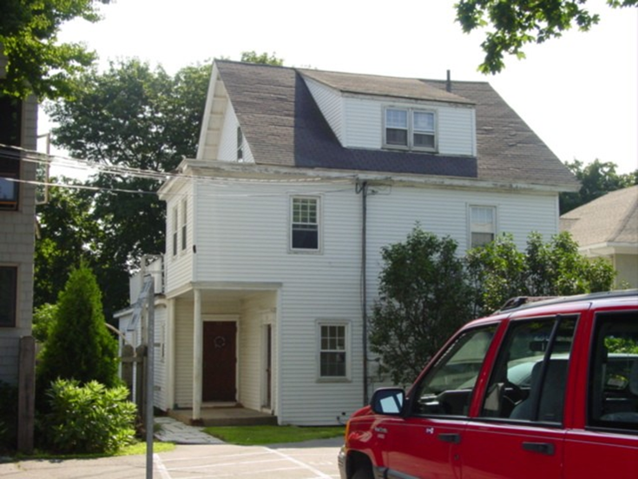
State Street
No. of Units: 4
Parcel Acreage: .256
Density: 15 units/acre
182 Pleasant Street
No. of Units: 4
Parcel Acreage: .216
Density: 18 units/acre
53 Allerton Place
No. of Units: 4
Parcel Acreage .114
Density: 35 units/acre

Slide 12
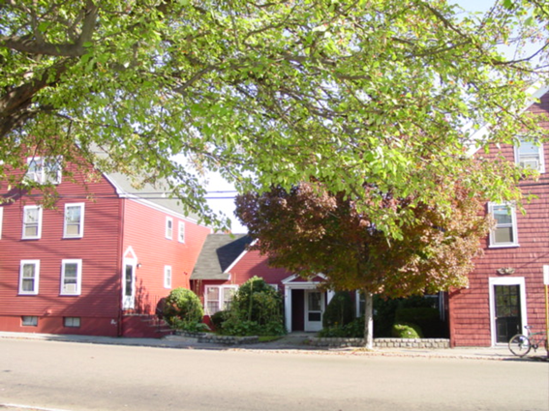
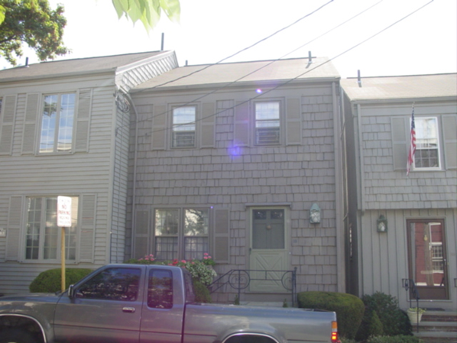
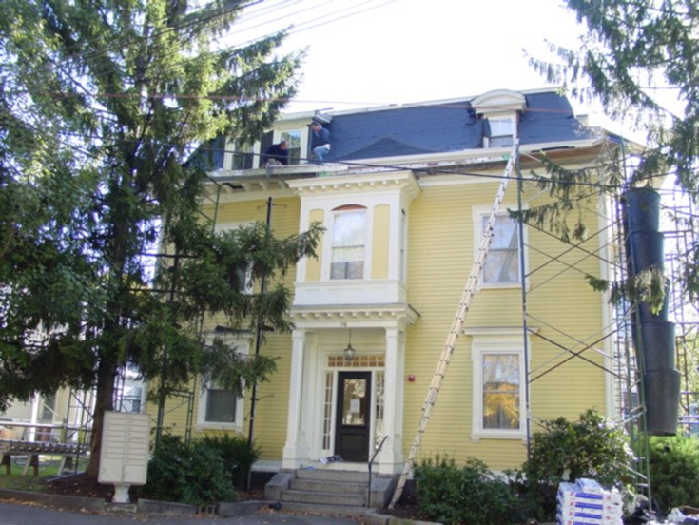
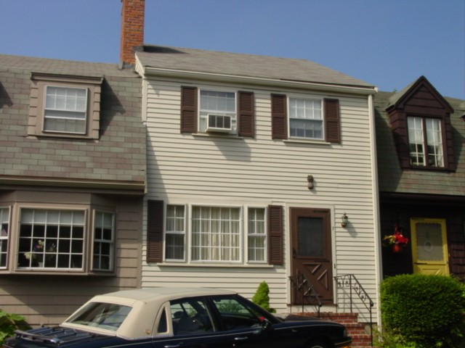
8 Franklin Street
No of Units: 20
Parcel Acreage: 0.477
Density: 41 units/acre
Bradford Court
Residential Units: 23
Parcel Acreage: .977 total
Parcel Density: 23 units/acre
78 Pleasant Street
No. of Units: 10
Parcel Acreage: .20
Density: 50 units/acre

Slide 13
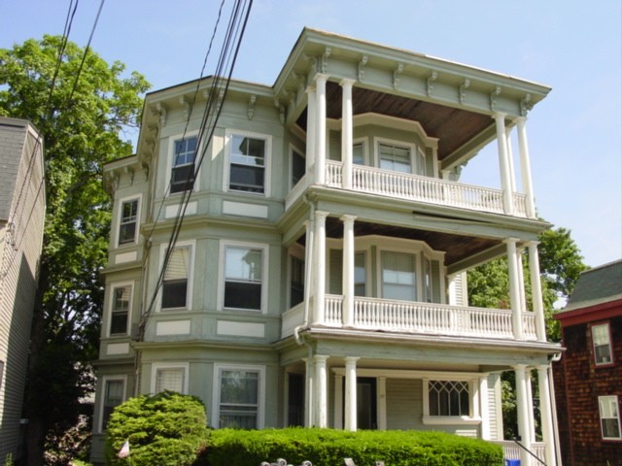
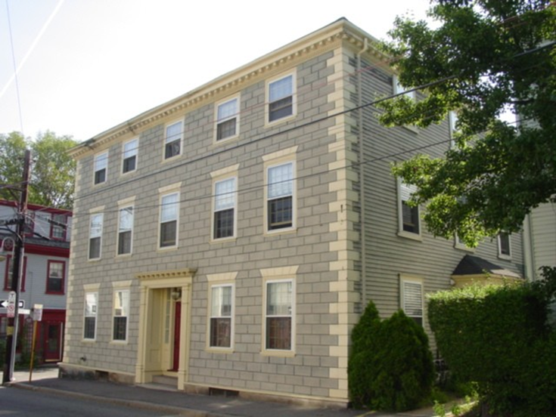
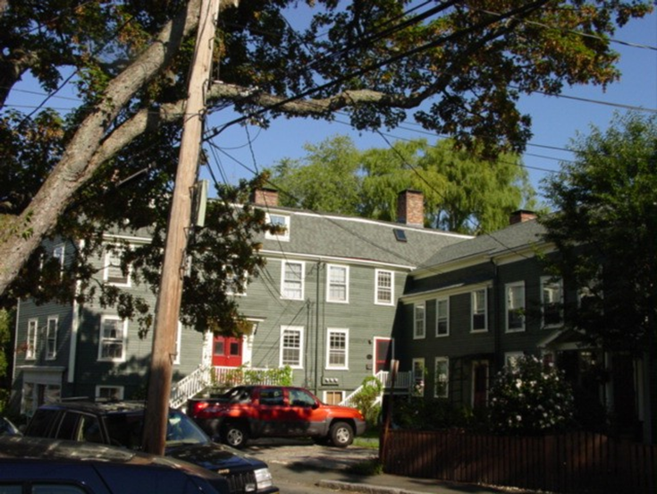
29 Pleasant Street
No. of Units: 9
Size of parcel: .08 acres
Density: 112 units/acre
1 bedroom units
52 Washington Street
No. of Units: 9
Size of parcel: .09 acres
Density 100 units/acre
1- & 2-bedroom units
18 /20 Darling Street
No. of Units: 5
Size of Parcel .208 acres
Density: 24 units/acre

Slide 14
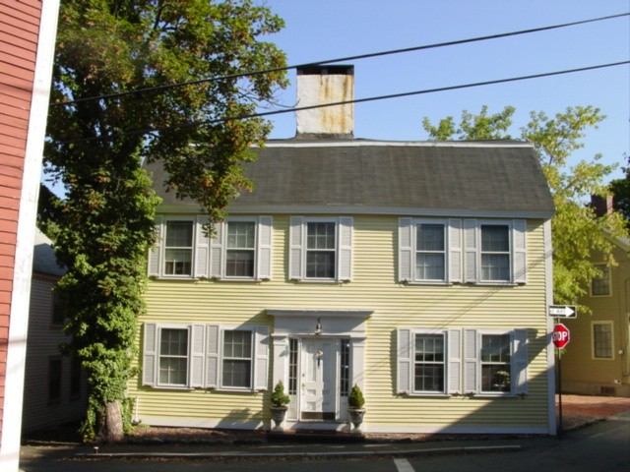
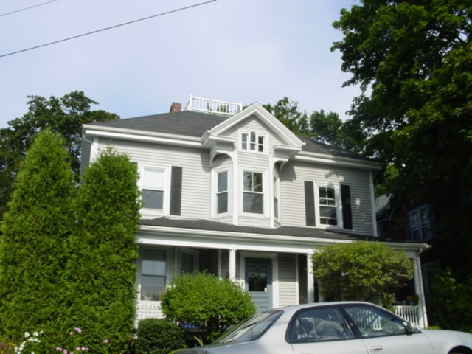
28 Darling Street
No. of Units: 5
Parcel Size: .09 acre
55 units per acre
59 Gregory Street
No of Units 4
Parcel Size: .188
21 units per acre

Slide 15
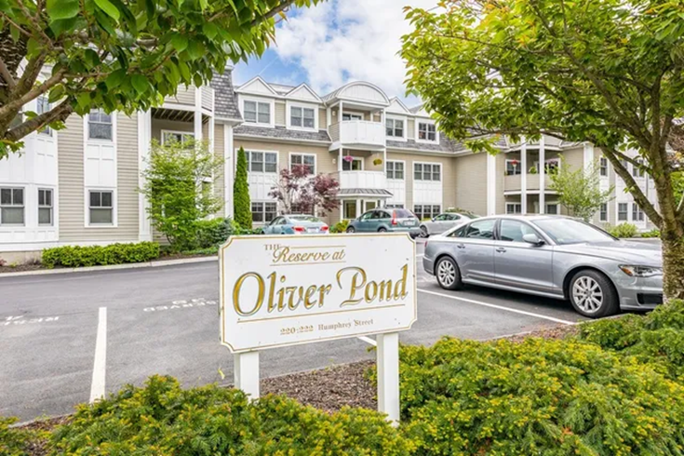
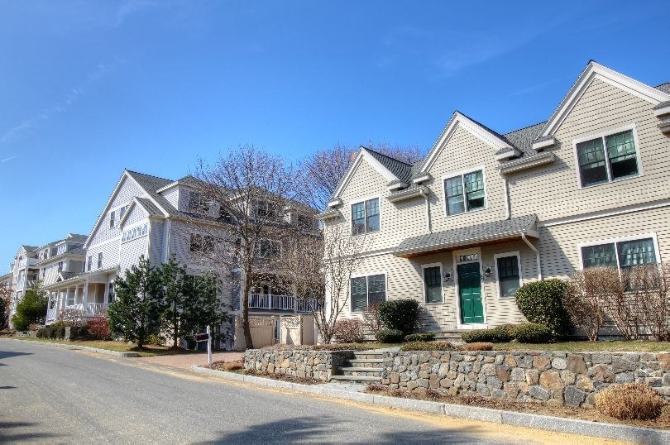
Reserve at Olivers Pond
No of Units: 20
Density:13 units per acre
Marblehead Highlands
No. of Units: 88
Parcel size: 4.4 acres
Density: 20 units per acre

Slide 16
Density
Property # of units area units/acre
Fort Beach Way 8 .37 ac 21
Heritage Way 23 1.60 ac 14
Story School 8 .58 ac 14
Ferry Lane 9 .40 ac 22
Leslie Cove 13 .57 ac 22
Colonial Court 9 .28 ac 32
Landfall Apts 45 1.17 ac 38
Lincoln Park 22 1.14 ac 19
Stonybrook Rd 11 .75 ac 15
Bradford Court 23 .98 ac 23
Frost Lane 18 .71 ac 25
Glover Landing 116 4.71 ac 24
Average units/acre 23

Slide 17
Marblehead Housing Stock

Slide 18
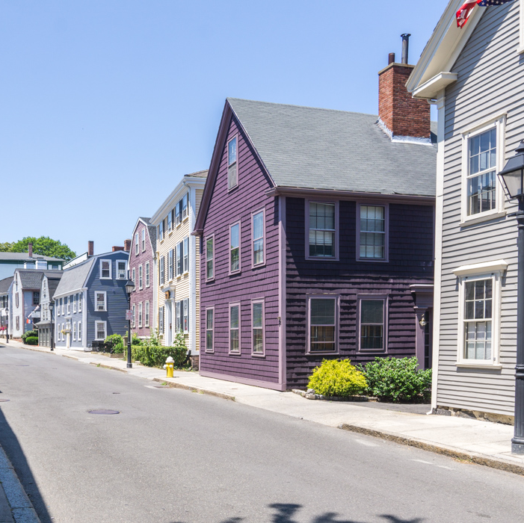
This density already exists in Marblehead
The housing type – multi family already existing in Marblehead

Slide 19
If we already have this density, why aren’t we in compliance?
Although Marblehead has many multi family housing units at high densities, they are scattered throughout the town.
We are required to have at least one district of a certain size and density where multi family use is allowed as a matter of right.

Slide 20
What is Zoning ?
A code that regulates how we can use land.
Includes:
Shape (height and size) of buildings
Distance between buildings and other land uses
What the land can be used for
Residential - single or multifamily
Commercial
Industrial
Can also include requirements for things like parking, affordability, and design standards
This is an amendment to our Zoning Bylaw

Slide 21
Presently we allow multi family by special permit in our unrestricted district
We also allow row houses (a type of multi family) in four of our zoning districts by special permit and we allow mixed use commercial with residential above in one district as a matter of right and by special permit in the others

Slide 22
How we have been doing this?
Take the existing district where multi family housing is permitted right now by special permit and make the changes to the dimensional regulations and allow by right
Look at expanding existing smart growth districts
Look at any areas with underutilized buildings to create a five acre district
Develop and apply criteria
guidelines so even as of right it has to be a certain size shape and look
There are many, many ways to approach this

Slide 23
Community Engagement
Public Forums
Zoom October 26, 2023, which was recorded and played on MHTV many times
In-person workshop/meeting November 2, 2023
A weeklong virtual open house December 1 to December 8, 2023
Presentation to Fair Housing Committee, Housing Production Plan Committee, Select Board Several newspaper articles
Focus groups have been held with:
o architects,
o Housing Committees
o developers
o department heads
o COA
o Chamber/business
An email distribution list has been created for updates/ website

Slide 25
Results of exercise

Slide 28
Process
We took in a lot of information
Looked into the concerns people had
Grant to assist us with the technical analysis Bohler Engineering

Slide 29
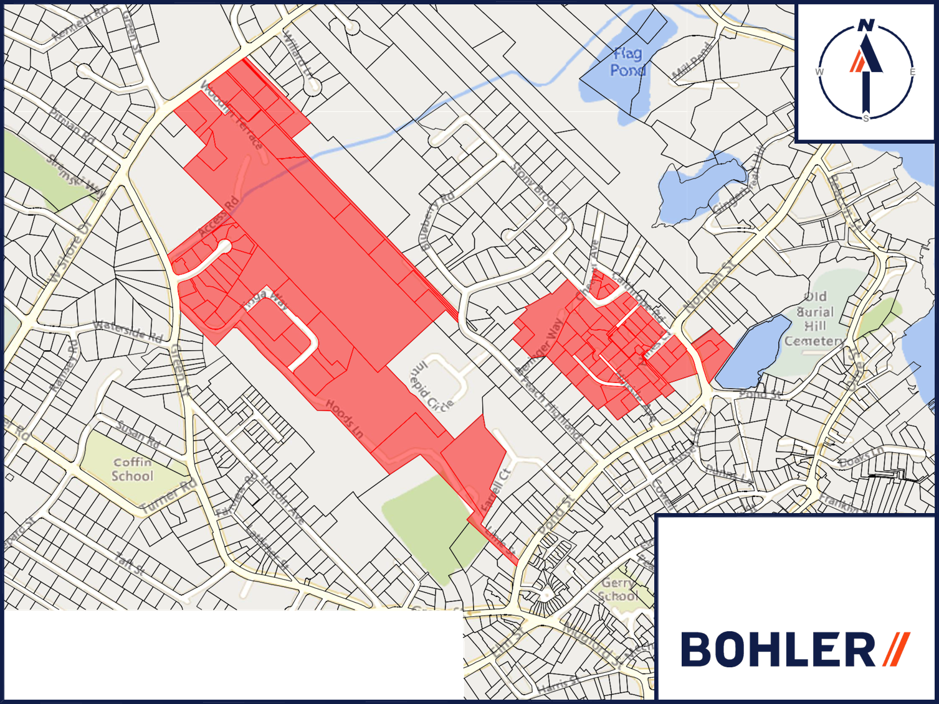
Existing Unrestricted District

Slide 30
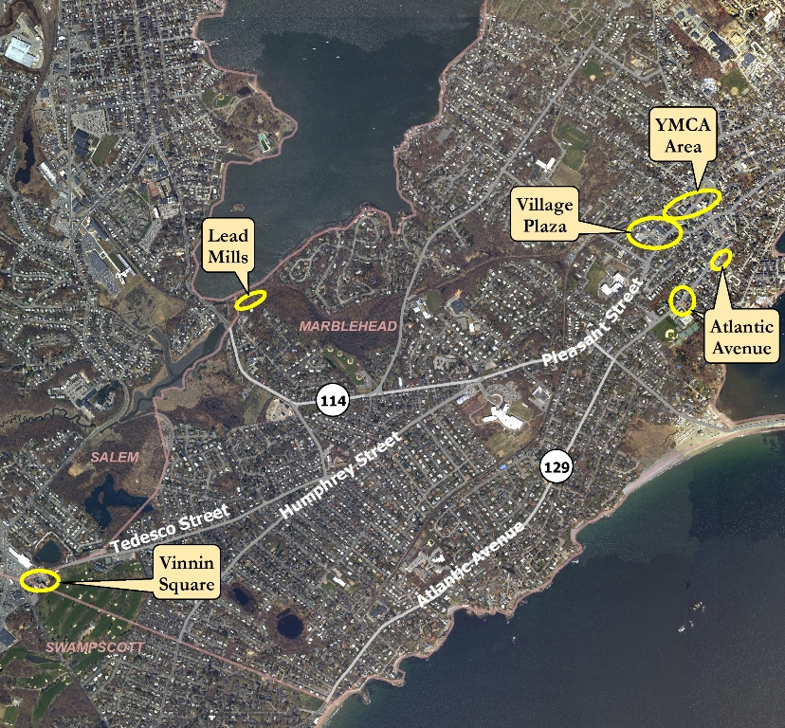
Smart Growth Study
2009

Slide 31
Expanding the area around Pleasant Street Smart Growth District
Promotes higher density downtown
Developing projects near public transportation to encourage the use of mass transit thereby reducing the impact of the car
Creating a range of housing types for people with a variety of income levels and needs
Creating walk‐able neighborhoods
Supporting the integration of mixed land uses
Providing a means to incorporate more compact building design as an alternative to conventional, land consumptive development

Slide 32
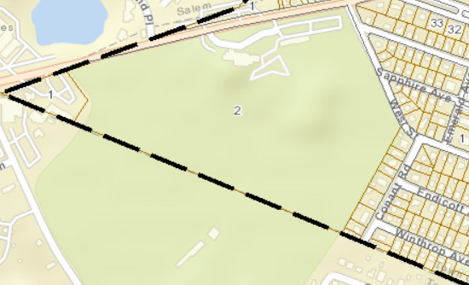
Expanding Vinnin Square Smart Growth District

Slide 33
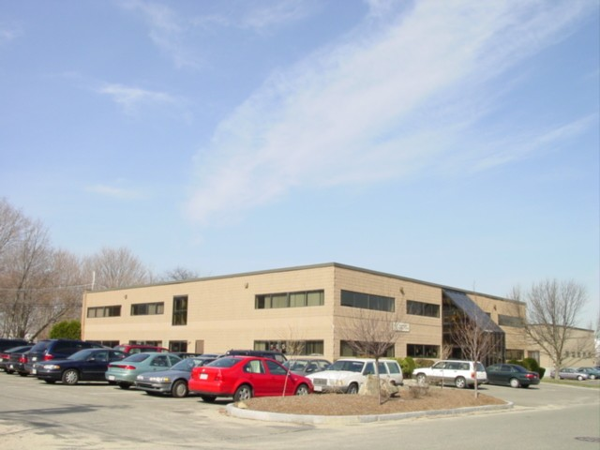
Under utilized buildings

Slide 34
JCC

Slide 35
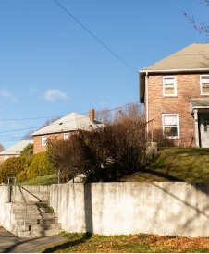
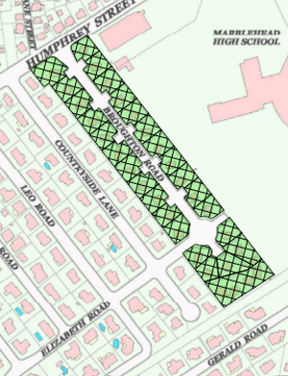
Broughton Road
Existing family housing owned and operated by the Marblehead Housing Authority
It was constructed in the 50’s and the new area in early 80’s
The Housing Authority is exploring redoing this area now
This area could be included in the overlay

Slide 36
After all that work, we developed a compliant model
Three districts
Broughton Road
Tioga Way
Pleasant Street
Not less than a total 27 acres
No one area is less than 5 acres
One of the areas is 50% of the total
Meets the capacity of 897 units
The density exceeds 15 units per acre

Slide 37
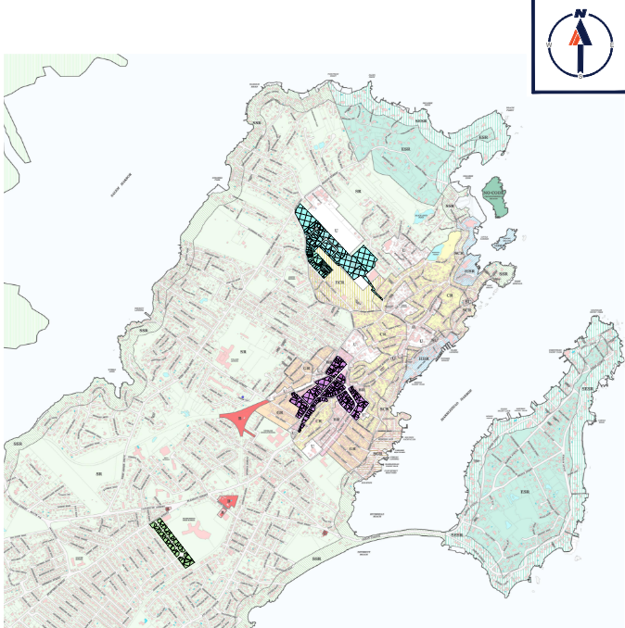
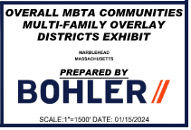
MARBLEHEAD STATE COMPLIANT PLAN

Slide 38
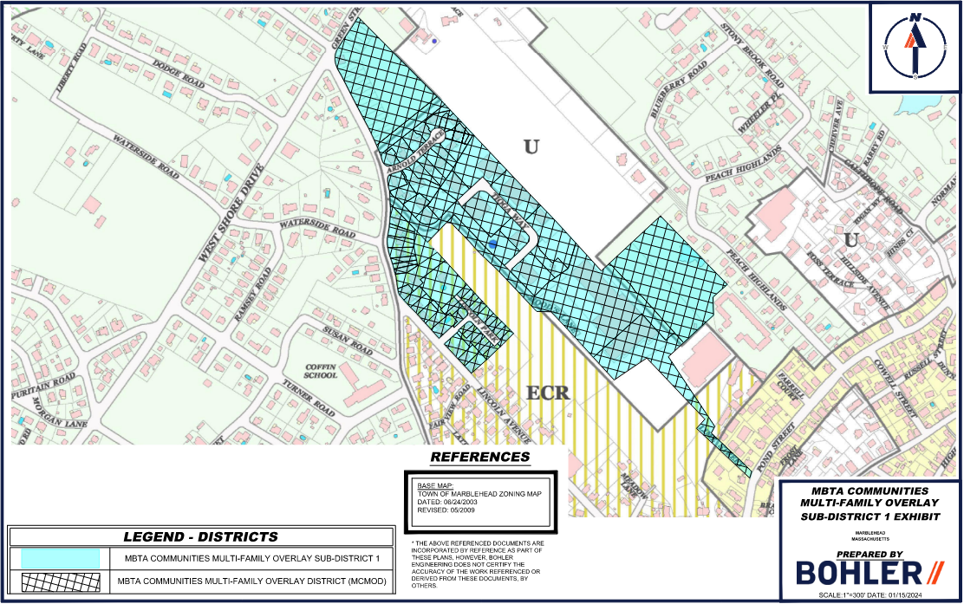
STATE COMPLIANT PLAN
PROPOSED DENSITY = 20 UNITS/ACRE
PROPOSED ACREAGE = 28.3 (51.8%)

Slide 39
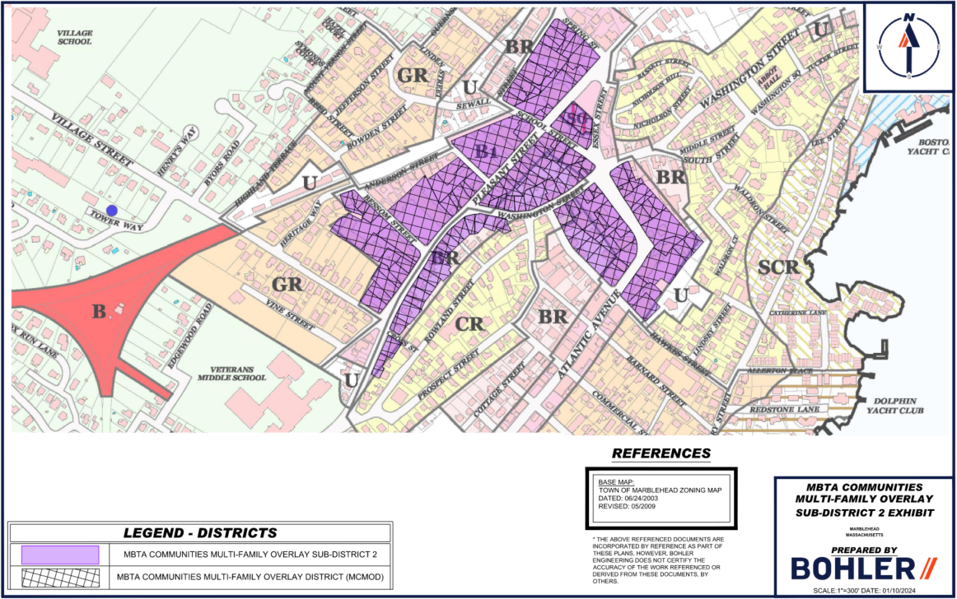
STATE COMPLIANT PLAN
PROPOSED DENSITY = 20 UNITS/ACRE
PROPOSED ACREAGE = 20.2 (37.0%)

Slide 40
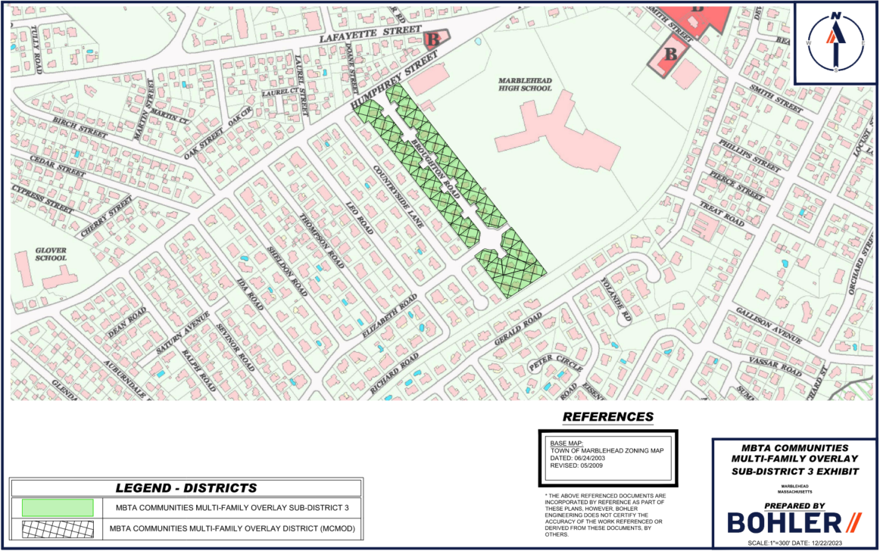
STATE COMPLIANT PLAN
PROPOSED DENSITY = 20 UNITS/ACRE
PROPOSED ACREAGE = 6.1 (11.2%)

Slide 41
UNITS PER ACRE
REQUIREMENTS VS. PROPOSED
 | LAND AREA | UNIT CAPACITY | UNITS PER ACRE
REQUIREMENT | 27 acres | 897 | 15
PROPOSED | 54.7 acres | 899 | 17.5 (AVERAGE)

Slide 42
UNITS PER ACRE
MCMOD SUBDISTRICT BREAKDOWN
 | TIOGA WAY (MCMOD 1) | PLEASANT ST (MCMOD 2) | BROUGHTON RD (MCMOD 3) | TOTALS
TOTAL DISTRICT ACREAGE | 28.3 (51.8%) | 20.2 (37.0%) | 6.1 (11.2%) | 54.7
DISTRICT ACREAGE (EXCLUDING EXCLUDED LAND) | 25.2 | 20.2 | 6.1 | 51.5
FINAL UNIT CAPACITY PER DISTRICT | 483 | 297 | 119 | 899
DWELLING UNITS/ACRE | 19.2 | 14.7 | 19.5 | 17.5

Slide 43
UNITS PER ACRE
PROPOSED ZONING PARAMETERS
MBTA COMMUNITIES MULTI-FAMILY OVERLAY DISTRICT (MCMOD)
 | TIOGA WAY (MCMOD 1) | PLEASANT ST (MCMOD 2) | BROUGHTON RD (MCMOD 3)
MAX. ALLOWED DENSITY | 20 UNITS/ACRE | 20 UNITS/ACRE | 20 UNITS/ACRE
MIN. LOT AREA | 6,000 S.F. | 5,400 S.F. | 7,500 S.F.
MAX. ALLOWED BUILDING HEIGHT | 3 STORIES | 3 STORIES | 3 STORIES

Slide 44
Impact on Schools
Statistically, market rate multi-family housing attracts individuals or couples without children or with fewer children due to factors like limited space, less suburban location, and lifestyle preferences. Families may opt for single-family homes for more space and a suburban environment better suited for raising children.

Slide 45
Impact on infrastructure and services
In the focus group with the department heads that included the utilities electric light, water and sewer drainage, engineering, - we learned that none of the areas we were contemplating had and problems with infrastructure capacity.
Additionally, unlike single- and two and three family residences, multi family development are required to have their own recycling and trash pick up

Slide 46
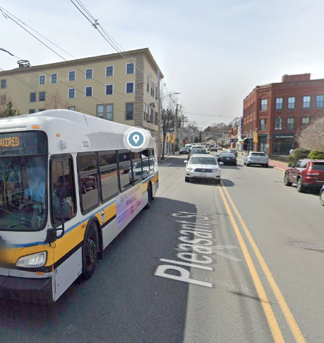
Impact on Traffic
Located two of the districts on a bus route
One district located in the business district
Smart growth incentives bike racks, parking for shared cars
Included areas that are already developed

Slide 47
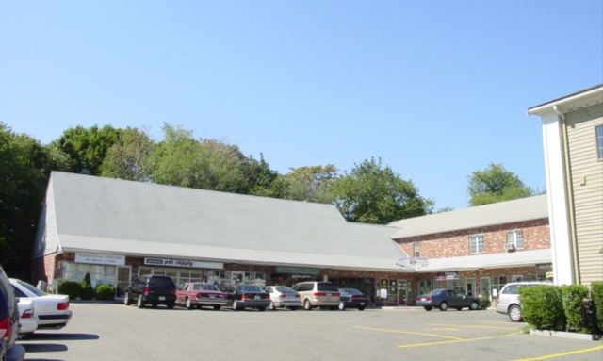
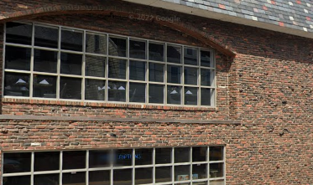
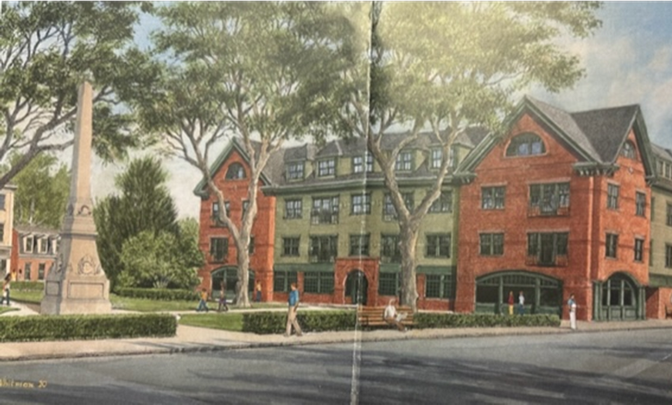
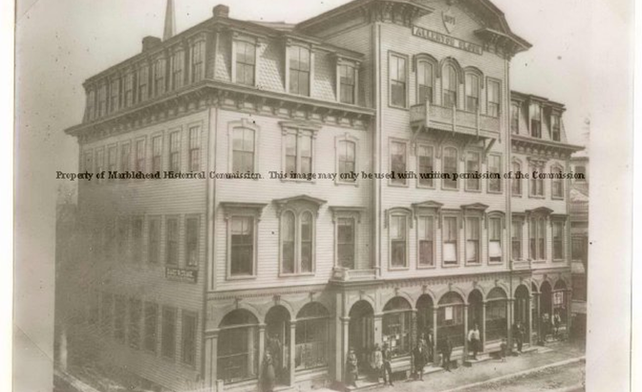
Impact on Character
Stayed out of the historic district
Included buildings that might benefit from redevelopment

Slide 48
This is a zoning mandate not a building project or a production mandate
Vinnin Square Smart Growth zone was adopted by Town Meeting in 2009 - the first application was in 2022
The Incentive zoning bylaw, which allows an increase in density townwide, was adopted in 1990 – the first and only application to date was in 2013 and the project was completed in 2021
Because the town has less than 10% affordable housing the town is subject to Chapter 40B. This allows a density increase in exchange for 25% of the housing units being affordable housing units. This can happen in any location in the town at any time. The law has existing since 1969 Marblehead has permitted four 40B developments two have been built and one is under construction the other was not built

Slide 49
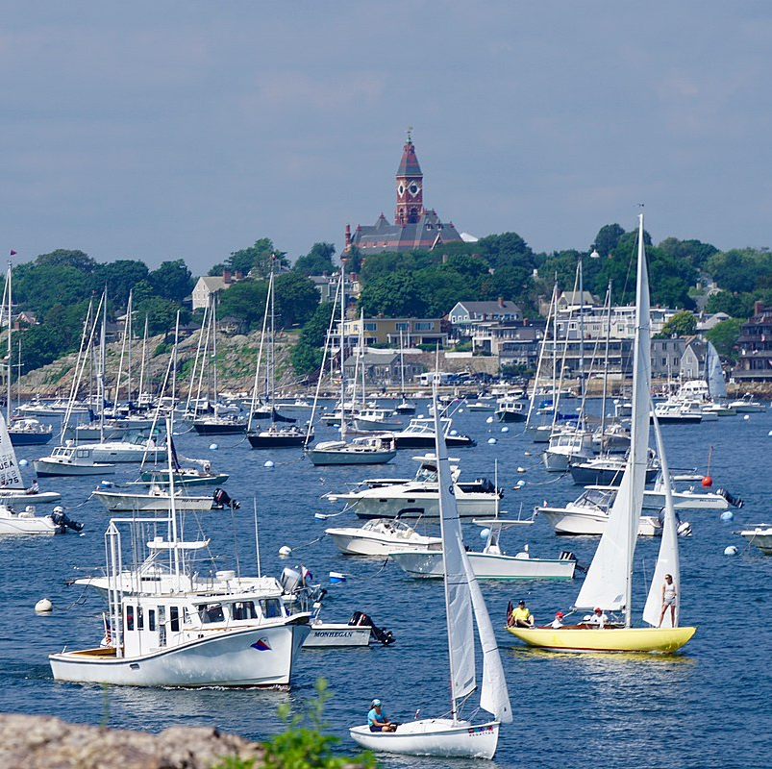
Summary
This model complies
We think we crafted it in such a way to give the town credit for some of the multi family we already have at this density and greater
Allows for some growth in areas that might benefit from redevelopment and without changing the character of the town
That it will benefit the town by providing a variety of housing types
ULTIMATELY THIS IS UP TO TOWN MEETING !

Slide 50
Timeline
Deadline for Compliance is December 2024
Present draft compliance plan tonight
Drop in January 17 4 -6 pm
Virtual Open House Jan17 to
Finalize preferred plan based on input
Submit to town warrant end of January
Education and outreach February to May
Vote at Town Meeting May 2024

