Slide 1
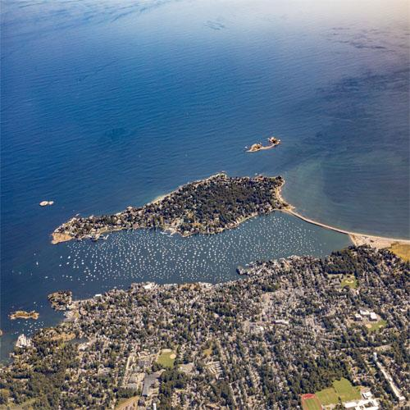
MBT ZONING
COMPLIANCE MODEL
Town Meeting- May 6, 2024

Slide 2
What is MBTA Zoning?
MBTA Communities Act
Massachusetts General Law Chapter 40A, 3A Passed by the State Legislature in 2021
MBTA Communities required to amend zoning: “at least one district of reasonable size in which multi-family housing is permitted as of right” at a minimum of 15 units per acre

Slide 3
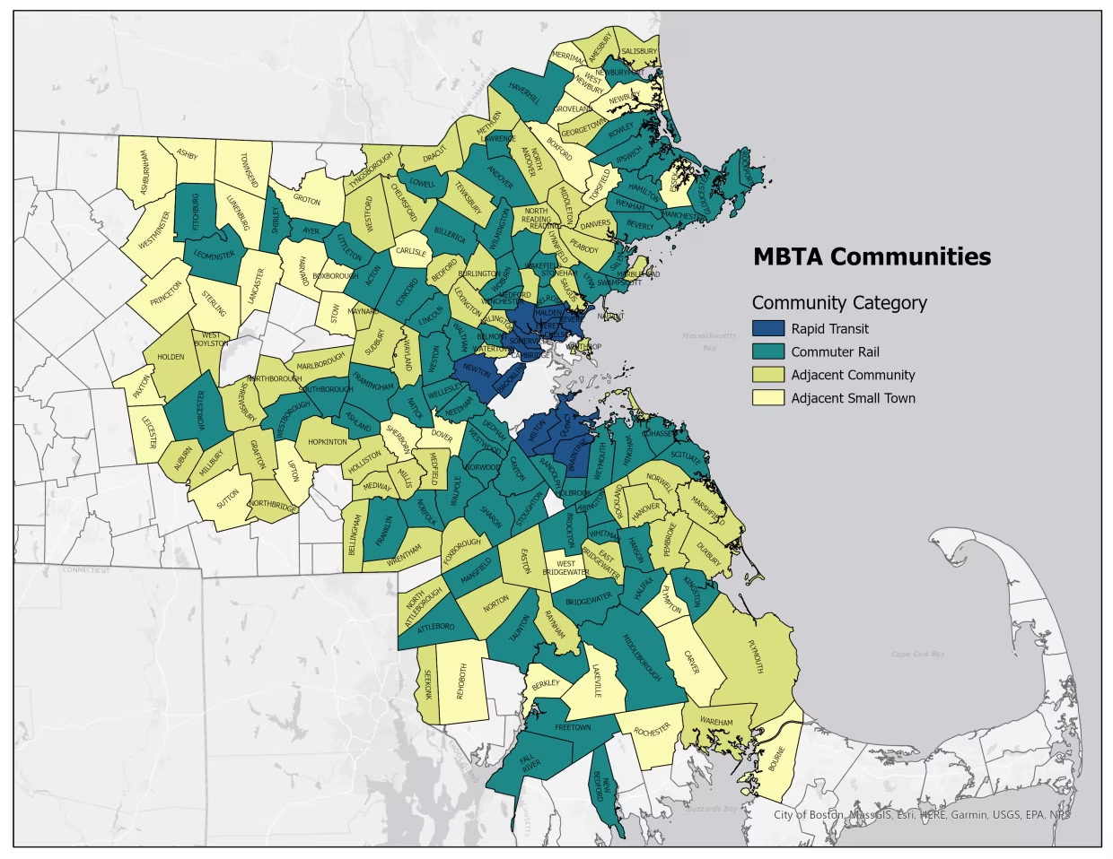
MBTA Communities
177 communities in the Commonwealth are included
Marblehead is classified as an Adjacent Community (to municipalities that contain MBTA stations)

Slide 4
What does it mean for Marblehead ?
Min. 1% of our total land area (2,771 acres) = 27 acres.
Min. 15 units per acres, allowed as a matter of right
Min 10% of the total housing units (8,965) = 897.

Slide 5
Parameters
District(s) can be located anywhere in town
Can be > one district
Each district min. > 5 acres
One district > 50% of total
Deadline: December 2024

Slide 6
If We Don’t Comply?
No mechanism for a town to opt out
May subject town to civil action.
Risks liability under federal and state fair housing laws.
Failure to comply results in loss of eligibility for State grant programs

Slide 7
Planning Board is obligated to consider options!
This is a reasonable plan with minimal impact to Marblehead

Slide 8
Our Process
Began Aug 2023
Reviewed massive amount of information
Sought Grant for technical analysis: Bohler Engineering
Considered Options:
Existing Unrestricted district (multi family housing is permitted now)
Expanding existing smart growth districts
Areas with underutilized buildings
Develop and apply criteria
Guidelines to preserve town character
Developed draft zoning amendment
Community input gathered through entire process

Slide 9
Community Engagement
Public Forums
Zoom Meeting, October 26, 2023, shown on MHTV many times
In-person workshop, November 2, 2023
Virtual open house, December 1 - 8, 2023
Presentations to: Fair Housing Comm., Housing Production Plan Comm., Select Board
Several newspaper articles
Focus groups:
o architects,
o Housing Committees
o developers
o department heads
o COA
o Chamber/business
email distribution list / website for updates

Slide 10
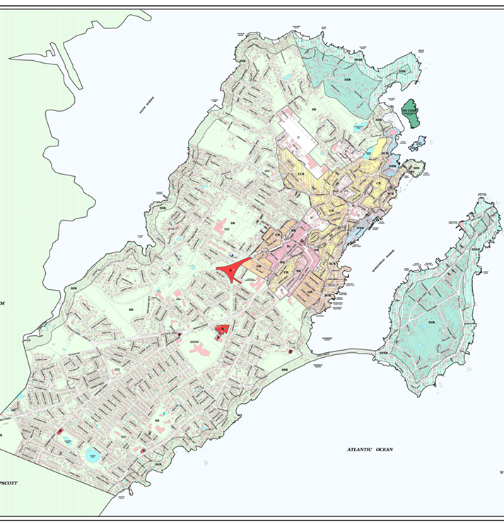
Present Zoning:
15 zoning districts + two overlay districts
Multi family allowed by special permit in Unrestricted District
Row houses allowed in four districts by special permit
Mixed use commercial with residential above allowed in one district as a matter of right and by special permit in the others

Slide 11
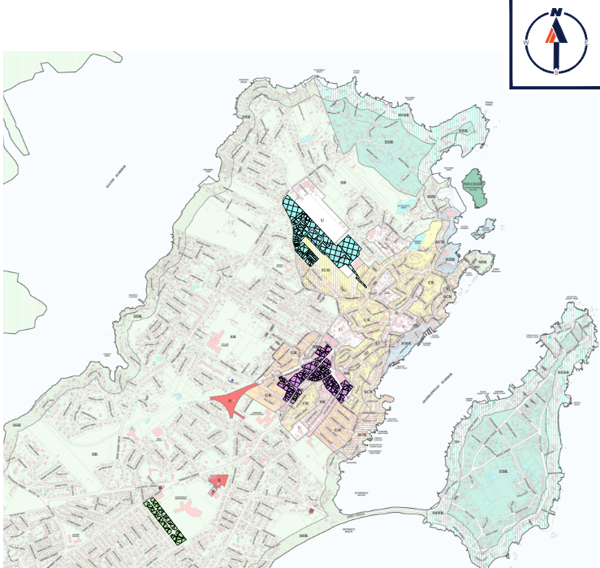
Three Districts
Compliant Plan:
Goals: Minimize density, spread out districts
- Tioga Way
- Pleasant Street
- Broughton Road
Total > 27 acres
Each > 5 acres
One > 50% of total
>/= 897 units
Density > 15 units per acre

Slide 12
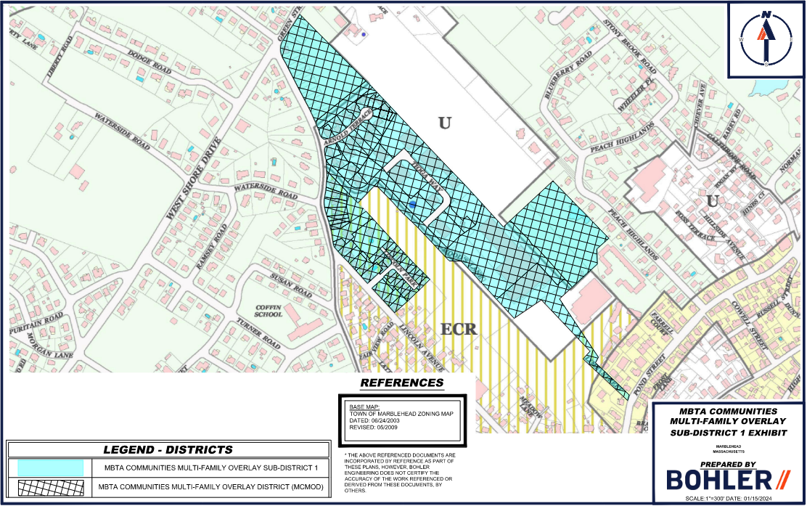
Sub-District 1: Tioga Way
Proposed Density = 20 Units/Acre
Proposed Acreage = 29.8 (51%)

Slide 13
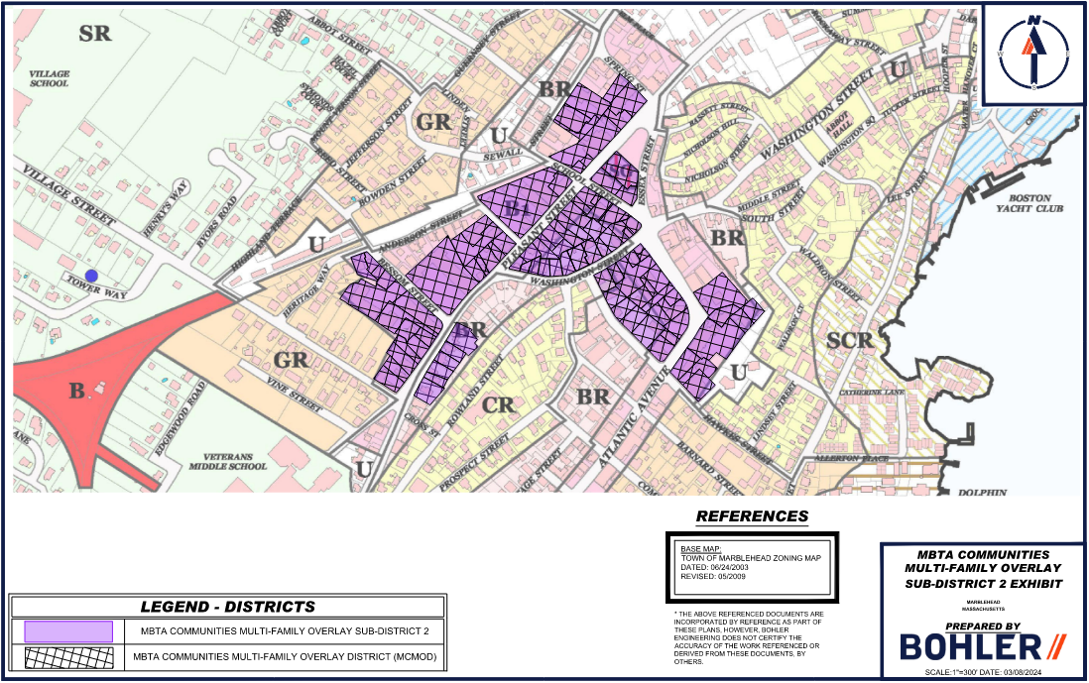
Sub-District 2: Pleasant St
Proposed Density = 20 Units/Acre
Proposed Acreage = 20.6 (35.3%)

Slide 14
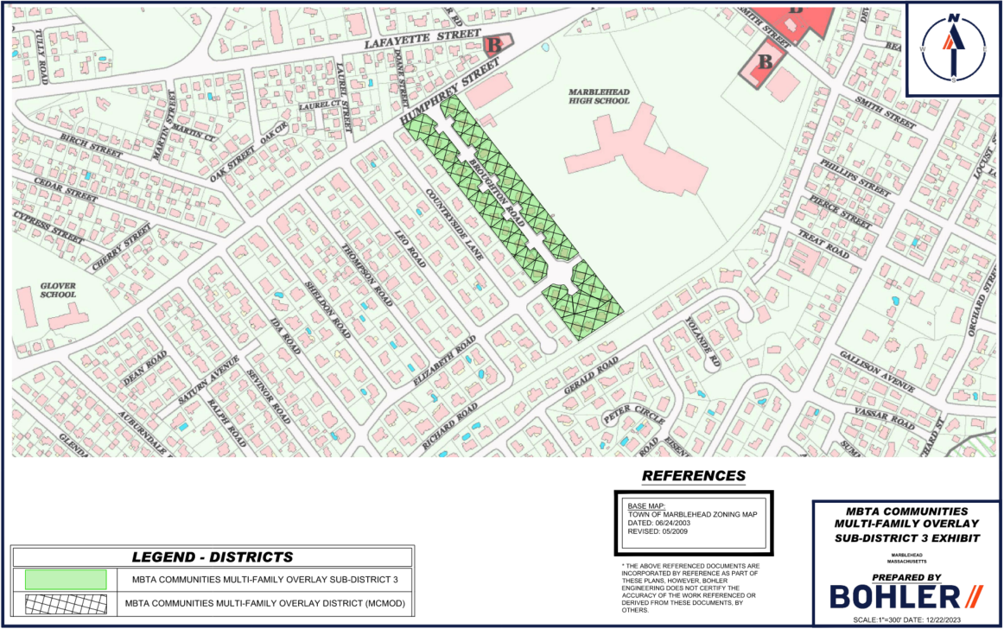
Sub-District 3: Broughton
Proposed Density = 20 Units/Acre
Proposed Acreage = 8.0 (13.7%)

Slide 15
15 Units Per Acre
This density is all around us – we already have this type of density and much denser
Notes:
All around us

Slide 16
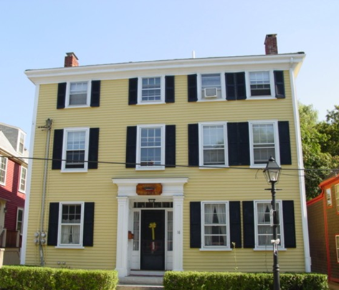
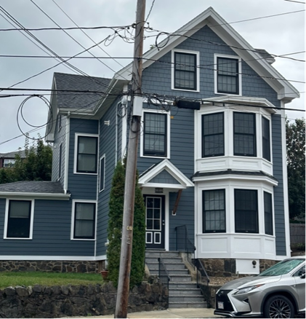
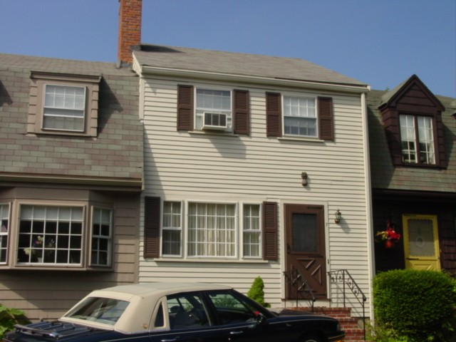
Similar Density
State Street
No. of Units: 4
Parcel Acreage: .256
Density: 15 units/acre
182 Pleasant Street
No. of Units: 4
Parcel Acreage: .216
Density: 18 units/acre
Bradford Court
Residential Units: 23
Parcel Acreage: .977 total
Parcel Density: 23 units/acre

Slide 17
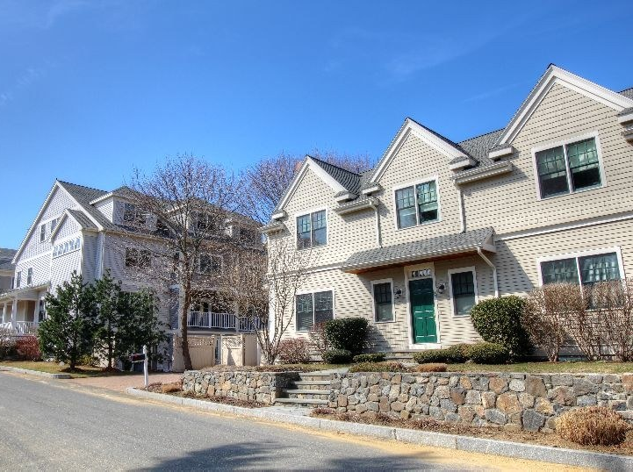
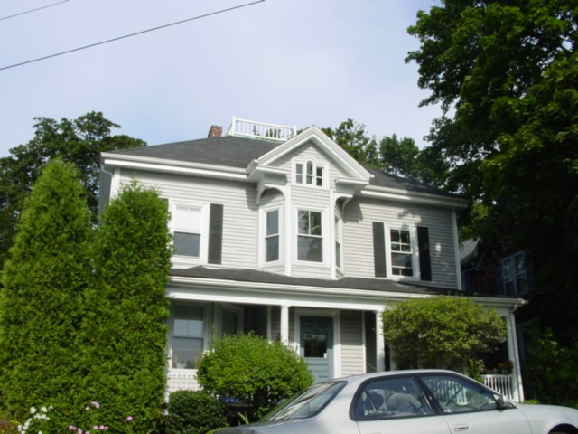
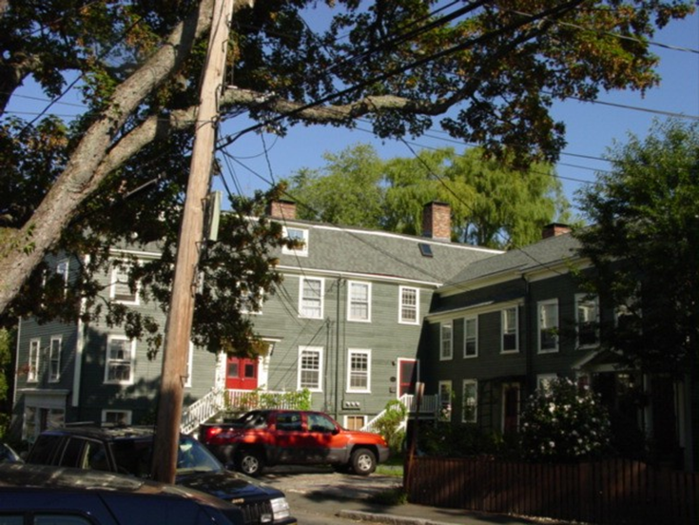
Similar Density
Similar Density
Marblehead Highlands
No. of Units: 88
Parcel size: 4.4 acres
Density: 20 units per acre
59 Gregory Street
No of Units 4
Parcel Size: .188
21 units per acre
18 /20 Darling Street
No. of Units: 5
Size of Parcel .208 acres
Density: 24 units/acre

Slide 18
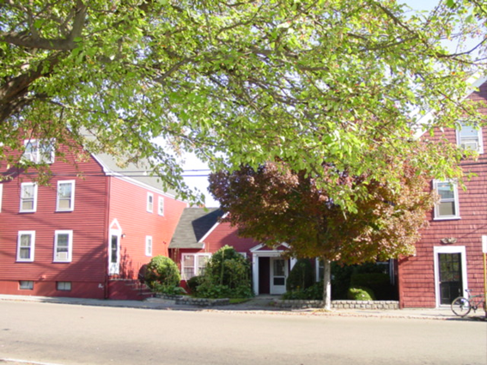
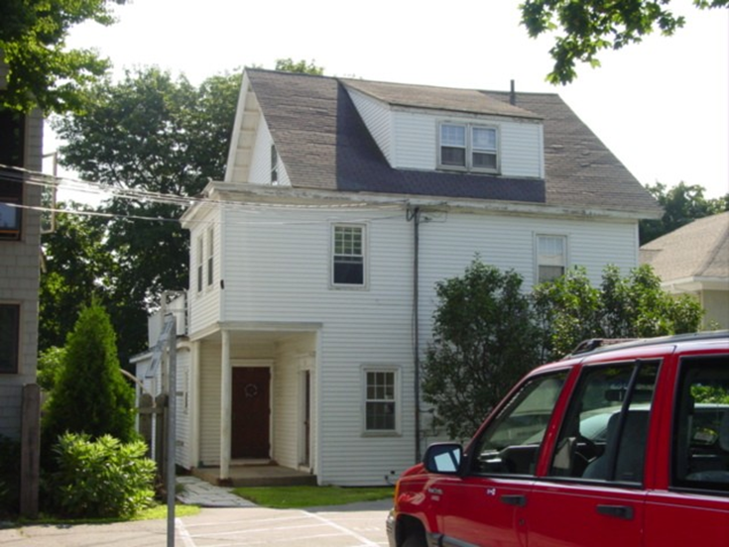
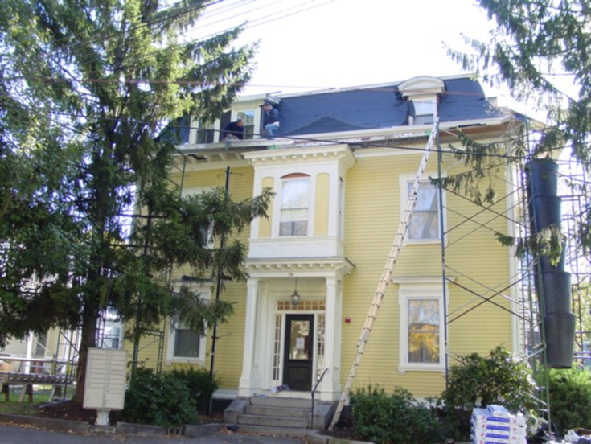
Greater Density
8 Franklin Street
No of Units: 20
Parcel Acreage: 0.477
Density: 41 units/acre
53 Allerton Place
No. of Units: 4
Parcel Acreage .114
Density: 35 units/acre
78 Pleasant Street
No. of Units: 10
Parcel Acreage: .20
Density: 50 units/acre

Slide 19
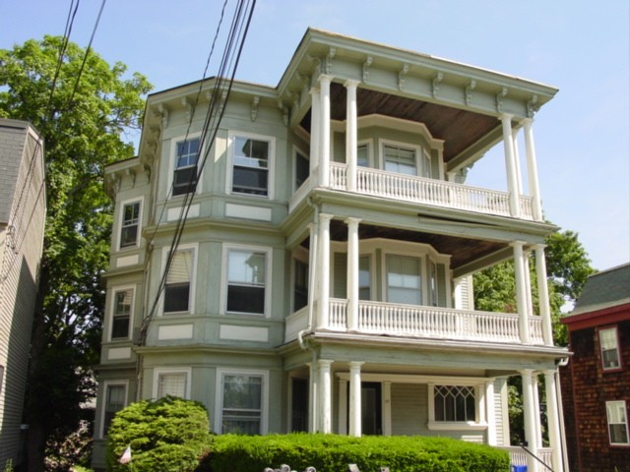
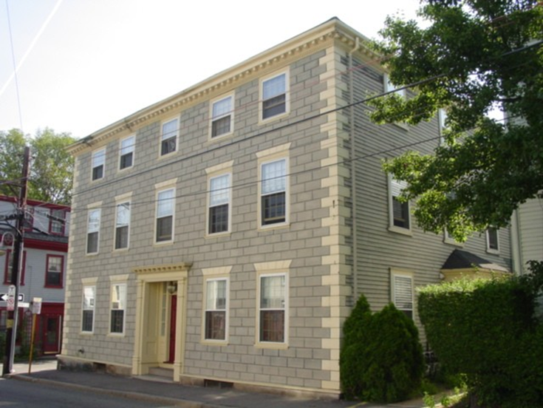
Much Greater Density
29 Pleasant Street
No. of Units: 9
Size of parcel: .08 acres
Density: 112 units/acre
1 bedroom units
52 Washington Street
No. of Units: 9
Size of parcel: .09 acres
Density 100 units/acre
1- & 2-bedroom units

Slide 20
Requirements vs. Proposed
GOAL: Keep Density as low as possible
 | LAND AREA | UNIT CAPACITY | UNITS PER ACRE
REQUIREMENT | 27 acres | 897 | 15
PROPOSED | 58.4 acres | 897 | 15.9 (AVERAGE)

Slide 21
MCMOD Subdistrict Breakdown
 | TIOGA WAY (MCMOD 1) | PLEASANT ST (MCMOD 2) | BROUGHTON RD (MCMOD 3) | TOTALS
TOTAL DISTRICT ACREAGE | 29.8 (51%) | 20.6 (35.3%) | 8.0 (13.7%) | 58.4
DISTRICT ACREAGE (EXCLUDING EXCLUDED LAND) | 27.9 | 20.6 | 8.0 | 56.5
FINAL UNIT CAPACITY PER DISTRICT | 483 | 295 | 119 | 897
DWELLING UNITS/ACRE | 17.3 | 14.3 | 14.9 | 15.9

Slide 22
Proposed Zoning Parameters
MBTA COMMUNITIES MULTI-FAMILY OVERLAY DISTRICT (MCMOD)
 | TIOGA WAY (MCMOD 1) | PLEASANT ST (MCMOD 2) | BROUGHTON RD (MCMOD 3)
MAX. ALLOWED DENSITY | 20 UNITS/ACRE | 20 UNITS/ACRE | 20 UNITS/ACRE
MIN. LOT AREA | 6,000 S.F. | 5,400 S.F. | 7,500 S.F.
MAX. ALLOWED BUILDING HEIGHT | 3 STORIES | 3 STORIES | 3 STORIES

Slide 23
Clarifying Misconceptions:
This Zoning change is:
Not about affordability
Not about hosting migrants
Not a mandate to build housing, just to allow for it
In Fact:
These density limits and zoning requirements are unlikely to induce much new development

Slide 24
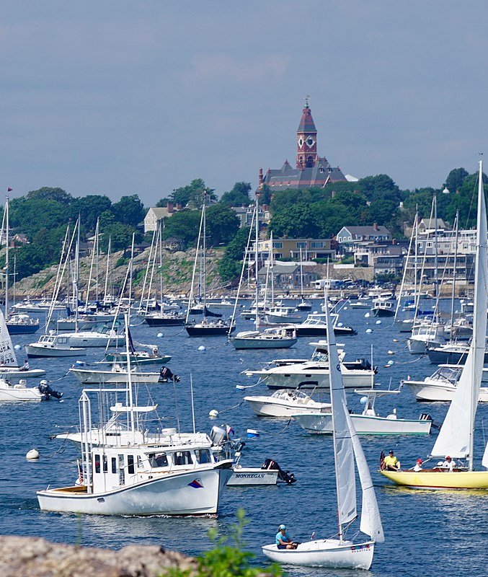
Summary
This is a Compliant model:
Minimal impact to Marblehead
Takes credit for existing multi-family housing
Districts can benefit from redevelopment
Zoning requirements and Site Plan review
will preserve town character
ULTIMATELY, THIS IS UP TO TOWN MEETING!

