Slide 1
MBTA Multifamily Zoning Requirements (Section 3A)
-----------

Slide 2
Agenda
What is the MBTA Community Zoning?
Why was the law passed?
What does this law mean for Marblehead?
Do we currently comply?
What does 15 units per acre look like in Marblehead?
What is the time frame for compliance ?
Where are we in the process?
Next steps – community engagement
Questions & Answers
Notes:
Do we need this slide?

Slide 3
What is the MBTA Community zoning?
MBTA Communities refers to Section 3A of Massachusetts General Law Chapter 40A, as passed by the state legislature in 2021. The law impacts 177 communities in four categories: Rapid Transit, Commuter Rail, Adjacent Communities, and Adjacent Small Towns.
The law requires that MBTA Communities must zone for “at least one district of reasonable size in which multi-family housing is permitted as of right” at a minimum of 15 units per acre.

Slide 4
Why was the law passed?
Zoning determines how we can use land, and it is one of the most powerful tools we have to meet our goals for housing, transportation, and climate resiliency.
Restrictive zoning creates excessive barriers to building more housing, which drives up costs for everyone.
The median home price in Marblehead is now over $1 million.
Legalizing multifamily housing by right will create more housing opportunities for families, older adults, young couples, and our local workforce.

Slide 5
What does this law mean for Marblehead ?
Marblehead is an Adjacent Community (adjacent communities are those that are adjacent to municipalities that contain MBTA stations).
This means that the district can be located anywhere within the town.
Marblehead’s district must be at least 27 acres, which represents just 0.2% of our total land area.
This law is not a production mandate.
The town needs to be in compliance by December 31, 2024.
The annual Town Meeting will need to approve changes to our zoning in order to comply, therefore any proposed zoning changes would need to be heard at the May 2024 Town Meeting. The warrant for the annual town meeting closes in late January/early February.

Slide 6
Do we currently comply with the law?
At present, Marblehead does not comply with the requirements. While we do have a zoning district of sufficient size that allows multi-family housing, the use is allowed by special permit and not by right and it does not meet all of the requirements. An analysis by the MassHousing Partnership found that with some changes, it could comply with the state requirements.
Communities that fail to comply will not be eligible for funds from 15 different discretionary grant programs, including the Housing Choice Initiative, the Local Capital Projects Fund, and the MassWorks infrastructure program. In March 2023 the State Attorney General additionally clarified that failure to comply may result in civil enforcement action or liability under federal and state fair housing laws.

Slide 7
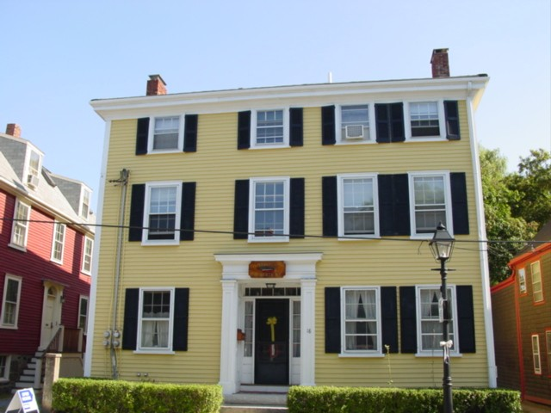
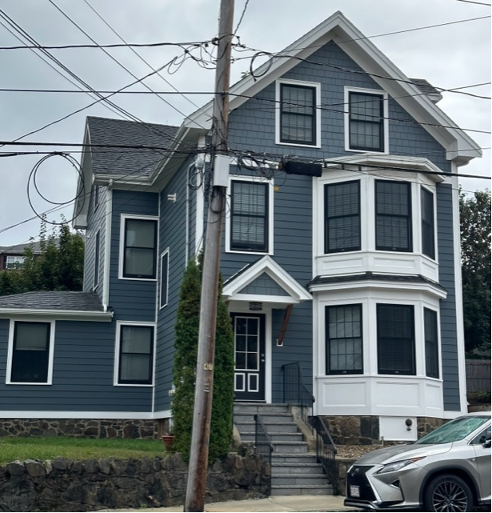
What does 15 units per acre look like in Marblehead?
State Street
Residential Units: 4
Parcel Acreage: .256
Parcel Density: 15 units/acre
182 Pleasant Street
Residential Units: 4
Parcel acreage: .216
Parcel Density: 18 units/acre

Slide 8
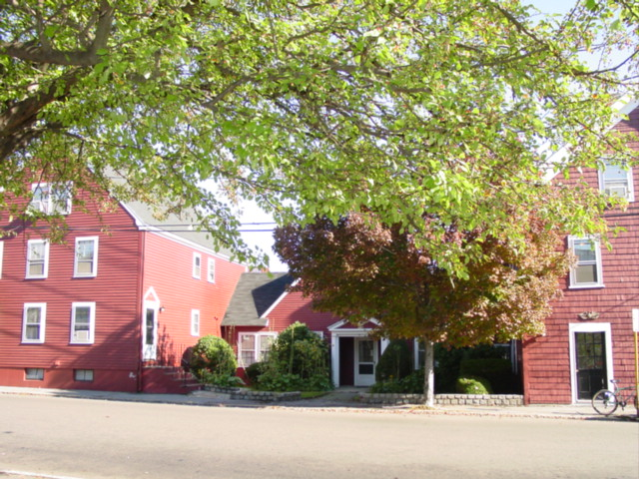
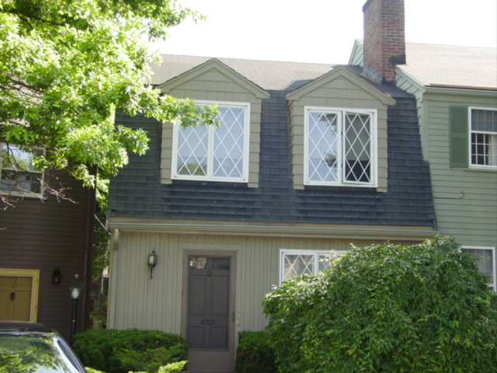
Multi family density look like in Marblehead
Bradford Court
Residential Units: 23
Parcel Acreage: .977 total
Parcel Density: 23 units/acre
8 Franklin Street
Residential Units: 20
Parcel Acreage: 0.477
Parcel Density: 41 units/acre

Slide 9
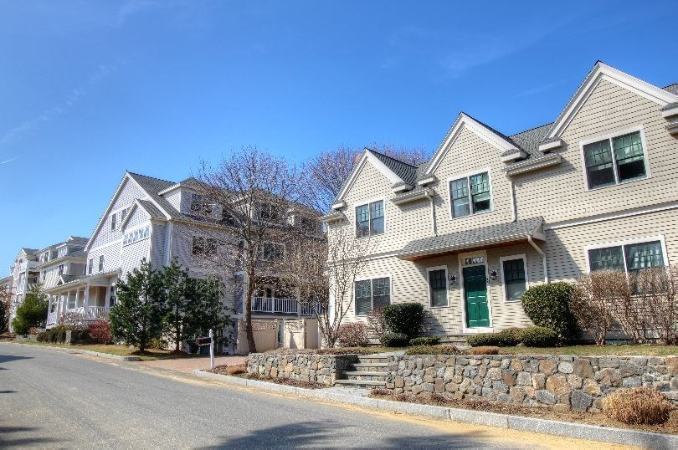
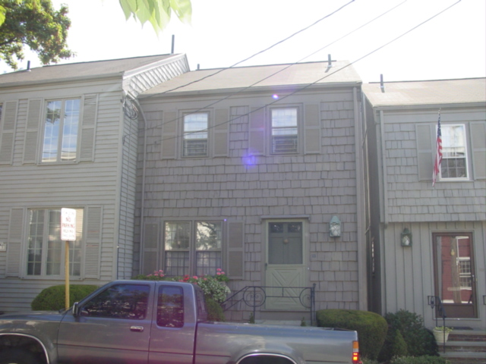
Multi family density look like in Marblehead
Marblehead Highlands
Residential Units 88
Parcel size 4.4 acres
Density: 20 units per acre
107-113 Front Street
Total Parcels Acreages: .104
Density: 40 units/acre

Slide 10
Where are we in the process?
April 2022: Held informational presentation by Town Counsel to the Select Board
Late 2022: Received early Technical Assistance from the MassHousing Partnership to test existing zoning districts
January 2023: Town submitted an action plan to remain in interim compliance
Fall 2023: Public engagement process to determine MBTA zoning district
January 2024: Place zoning changes on Town warrant
May 2024: Vote on zoning changes at Town Meeting

Slide 11
Community Engagement
There are many ways to change our zoning to reach compliance, and we want to hear from the community about your priorities.
The process will begin with this meeting then scheduling a public visioning session to get input from residents on what sizes and styles of multi-family housing are preferable and in what locations.
Additional methods of stakeholder engagement need to be developed to gain resident input
We have the ability as we craft our zoning to choose the locations, set dimensional controls (lot size, setbacks, lot coverage, etc.), provide design guidelines, parking requirements, and more.
These changes are an opportunity for Marblehead to have meaningful discussions on our goals for the future of our community.

Slide 12
Potential Community Engagement Methods
Open Public Meetings/Hearings
Educational Panels, Forums, and Webinars
Interactive Events (design charrettes, visioning sessions, tabling at community events)
Focus Groups (smaller group discussions)
Surveys

Slide 13
QUESTIONS?

