Slide 1
Accessory Dwelling Units
Planning Board Forum
November 15, 2022

Slide 2
Agenda
Welcome and Introductions
Presentation on ADUs
Work to date
Community Feedback
Q&A
Next Steps

Slide 3
Introductions
Marblehead Planning Board
Chairman – Bob Schaffner
Vice Chairman – Ed Nilsson
Andrew Christensen
Barton Hyte
Rossana Ferrante
Steve Leverone – Associate Member
Becky Cutting – Town Planner

Slide 4
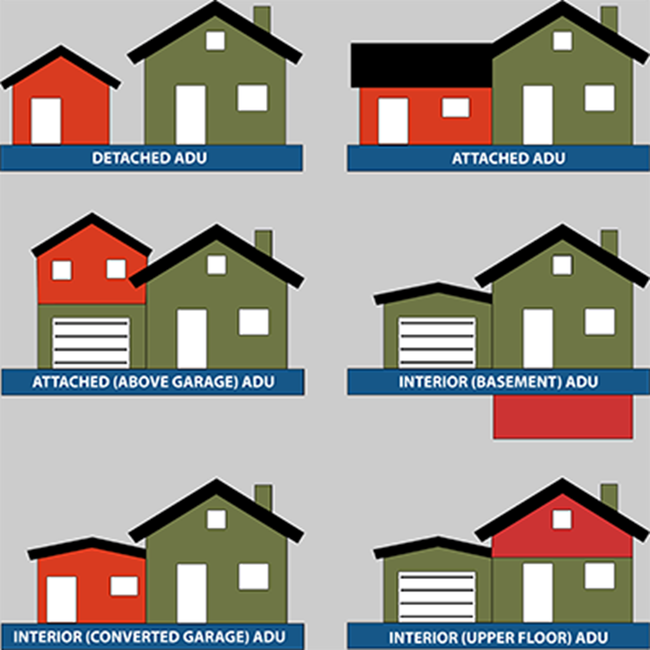
What is an Accessory Dwelling Unit?
An Accessory Dwelling unit (ADU) is a second small unit on the same property as single family house
It can be located within a house, attached or detached

Slide 5
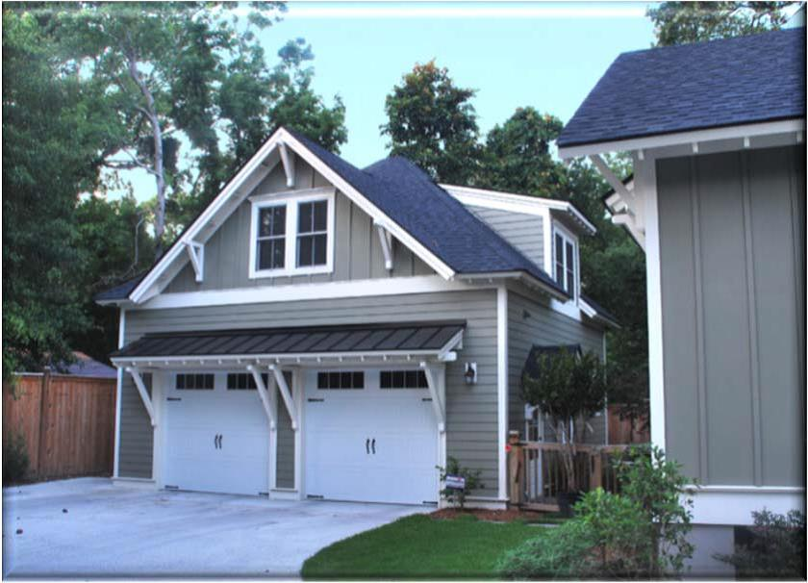
A common feature of all accessory units are that they are self-contained and subordinate to an existing dwelling

Slide 6
Why we are looking at ADU’s
The population in Marblehead is aging. Demographic data shows that the number of persons over 55 has increased by over 20% in the last 10 years.
As people live longer, more housing options are needed.
Increasingly, people are asking about options for parents and adult children to live with them and ways to remain in their houses.
The Housing Production Plan completed in 2020 identify ADU’s as a way to create naturally occurring affordable housing .

Slide 7
Why we are looking at ADU’s
In the town’s recently completed Housing Production Plan (2020)
Accessory dwelling units were specifically called out in an action plan
ADOPT ZONING THAT ALLOWS SMALL DIVERSE HOUSING TYPES Zoning that allows cottage homes, detached accessory dwelling units, co-housing, and tiny homes will create more naturally occurring affordable housing (NOAH) in the town.

Slide 8
Benefits of ADUs
Allow for family to live on same property (elderly parent or adult child)
• Can be used for family caregivers
Can provide rental income, especially for retirees
Allow seniors with large houses the opportunity to age in place and downsize, rather than displacement
ADUs tend to be lower-priced, so “naturally affordable” housing is produced
Converting illegal apartments to legal ADUs can improve safety
Distribute new housing within existing buildings rather than new larger
buildings (look of town character stays the same)

Slide 9
Work to date
Researched what other communities have done
Held a public forum in June
Held several working meetings
Developed a draft bylaw that is still a work in progress

Slide 10
Resources

Slide 11
How many can we expect
A review by the Pioneer Institute on Public Policy of 100 cities and towns around (but not including) Boston found that, among the 37 communities that allow ADUs, only 2.5 are built per year
Closer to home in the past three years three were built in Swampscott , seven in Ipswich and ten in Peabody.

Slide 12
Draft
There are certain things we know
One ADU per property
Either the ADU or the primary residence must be occupied by the owner
One parking space for each ADU must be provided
The units can not be separated and sold
Short term rentals (Airbnb) are prohibited
Process – by right in certain circumstances and by special permit in others

Slide 13
Things we don’t know
Size limitation limit to 2 bedroom or a maximum of 900 square feet or 1000 Square feet
How to ensure rules are followed – affidavits, certifications, annual inspections, enforcement
Limit rent to 60% or 70% of area rents as determined by HUD (greater affordability) or no restriction (more likely to be built)

Slide 14
Community Feedback
We are interested in your opinions please, use raise hand function, chat function or send information after to rebeccac@marblehead.org
We have promised to and must end the meeting by 7:30 PM
Other resources
https://ma-smartgrowth.org/wp-content/uploads/2019/01/ADU-MSGA-Pioneer-paper-2018.pdf

Slide 15
Next Steps & Time Line
Refine & finalize through January 2023
Public hearing on final draft – January 10, 2023
Submit bylaw amendments for inclusion in warrant – end of January 2023
Educate and Build support February to May 2023
Planning Board official public hearing - April 11, 2023
Action voted at Annual Town Meeting May 1 or 2, 2023

